Slide 1
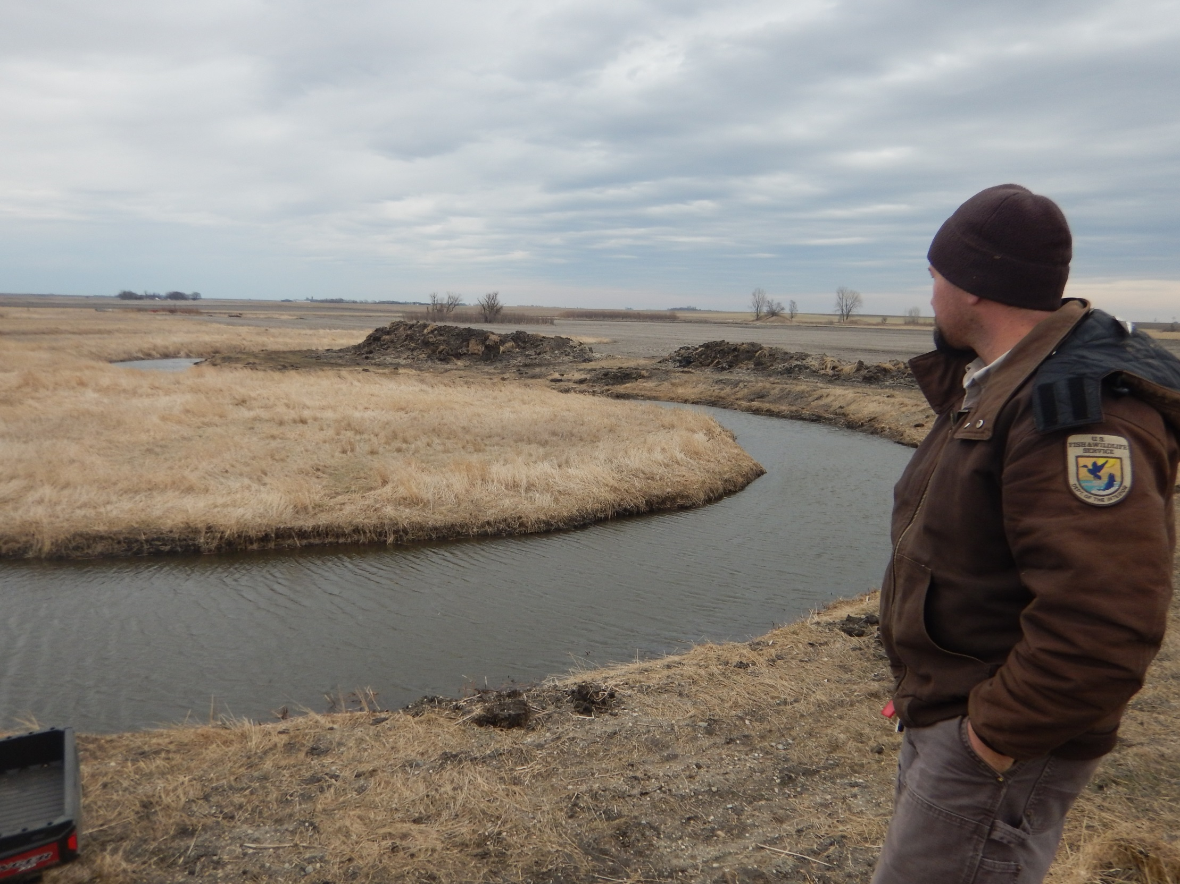
Oxbow Restoration and Monitoring in Prairie Streams for Topeka shiner Recovery in SW, MN
Scott Ralston – Fish & Wildlife Biologist, USFWS Windom, MN
This Presentation Available to Download
http://skralston.com/USFWS/

Slide 2
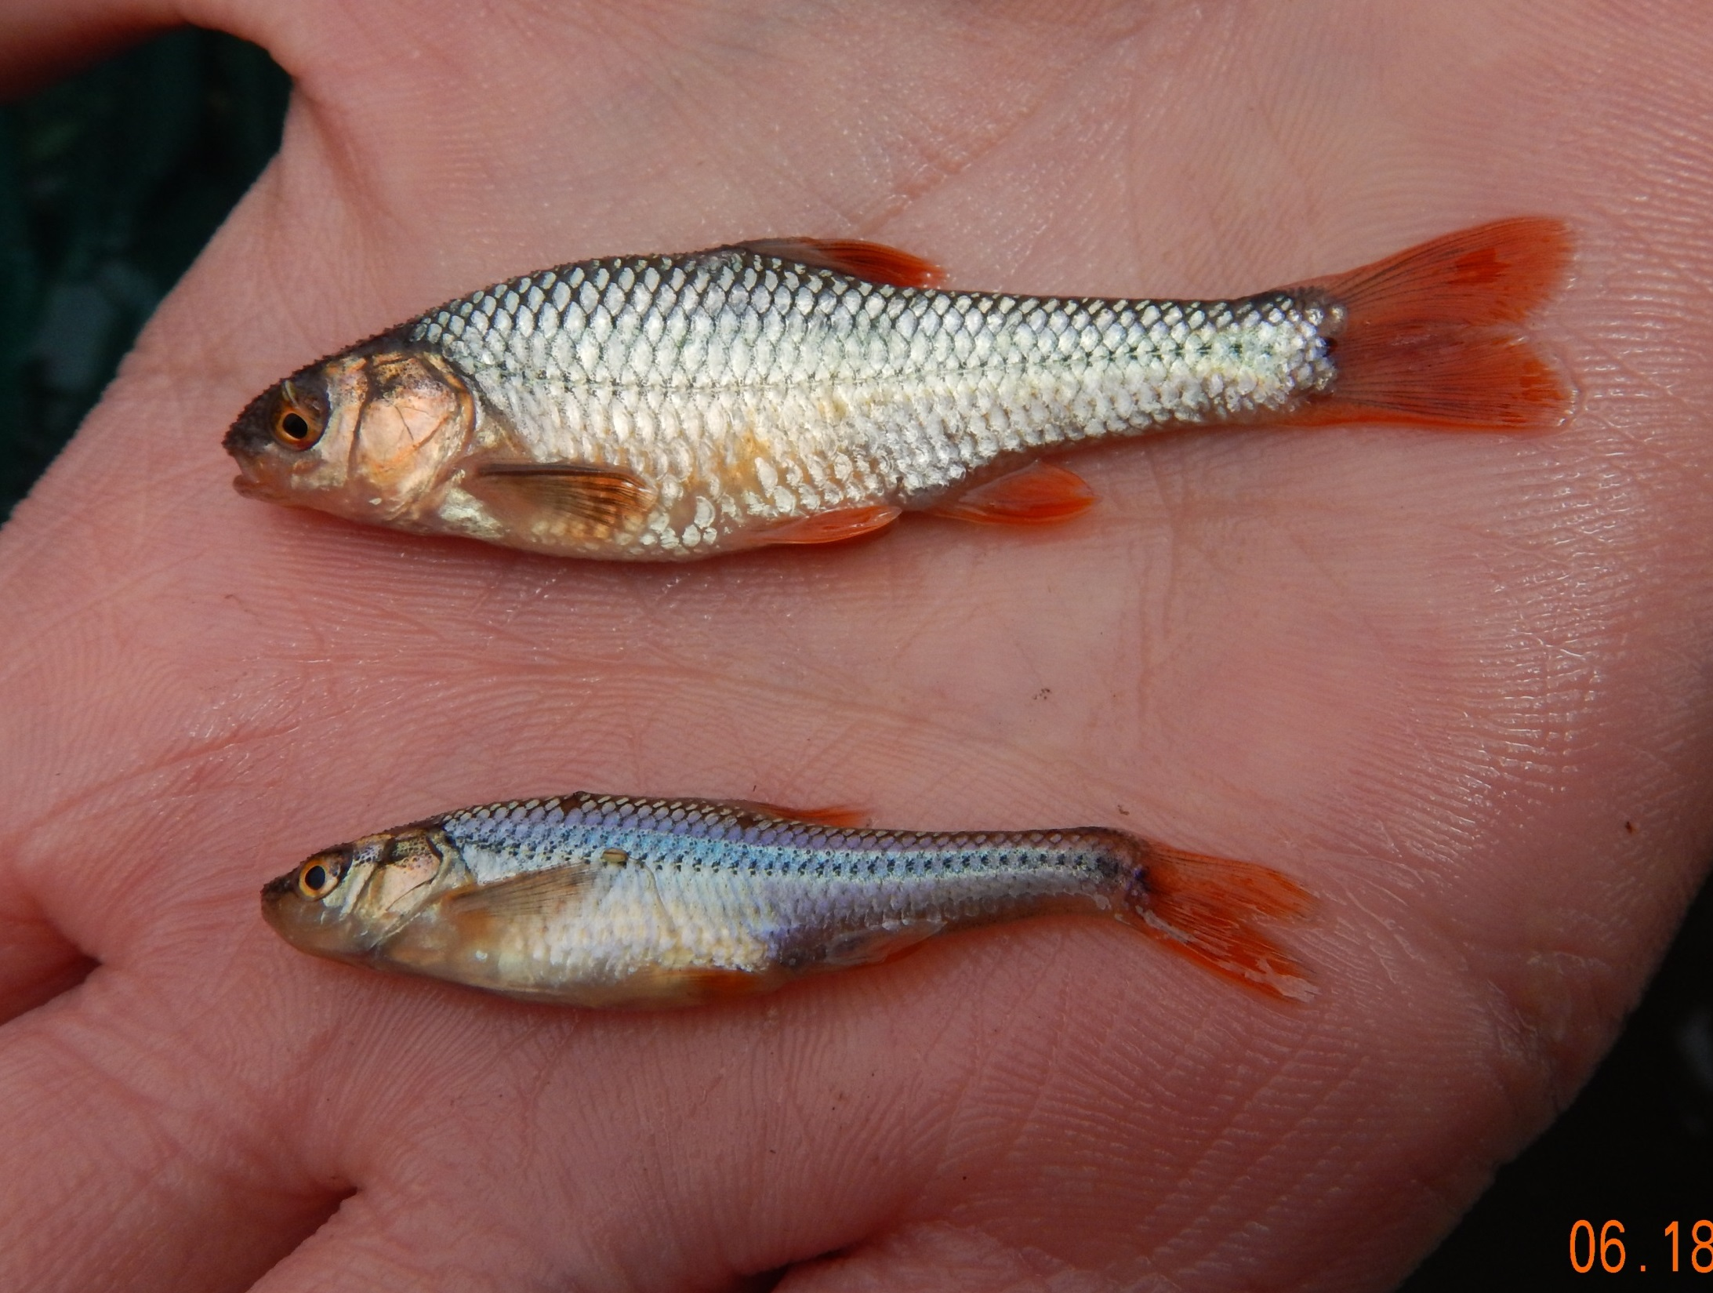
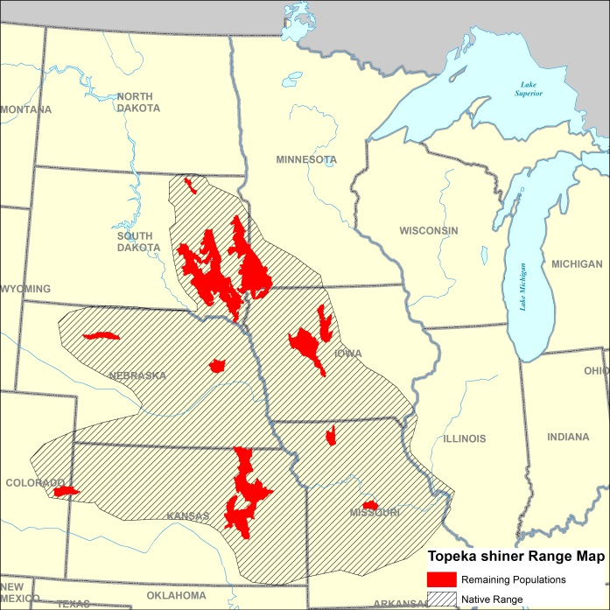
The Need
Topeka shiner – On Endangered Species list since 1998
Needs habitat in slow moving backwater pools
Increased drainage and intensive agriculture has caused high stream flows, increased erosion & sedimentation, channel entrenchment & filling in oxbows
From 2010-2013 observed presence dropped by about 50% (DNR Surveys)

Slide 3
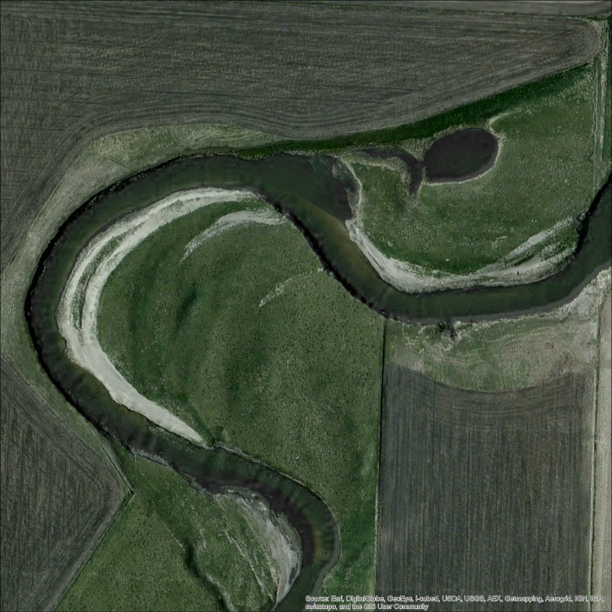
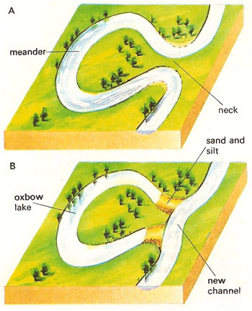
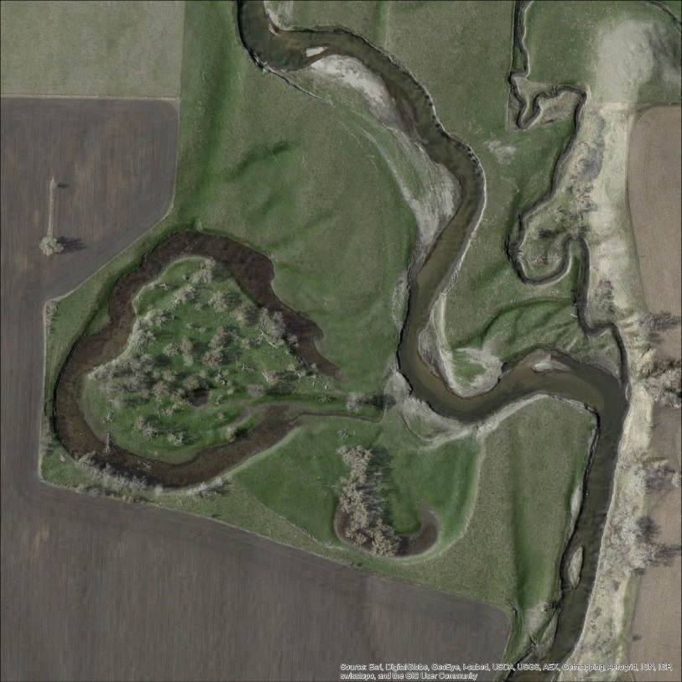
What is an Oxbow or off-channel wetland?

Slide 4
Typical Oxbow Filled in with Sediment

Slide 6
Restoration Initiative Project
Goal – Work Toward Eventual Downlisting!
Working with Partners, Educating Public and Building Trust
Brought together many different partners including various divisions of the FWS, State DNR, County SWCDs, Private Landowners
Received $1 million in Cooperative Recover Initiative funding (CRI) 2015 and Another $1mill starting in 2018.
Other partner funding included: State CPL grants, PFW funds, USFWS Fish Passage funds, NWR Funds, Private Landowner contributions, NRCS EQIP, Watershed Districts, counties and more.

Slide 7
Types of Projects
Oxbows/off-channel wetland restorations
Barrier Removals – Dams, Perched Culverts
Channelized/Ditched streams re-meandered
Streambank and grade stabilizations
Floodplain connections
Watershed improvements
Upper watershed wetland restorations
Vegetative Buffers
Outreach/Education

Slide 8
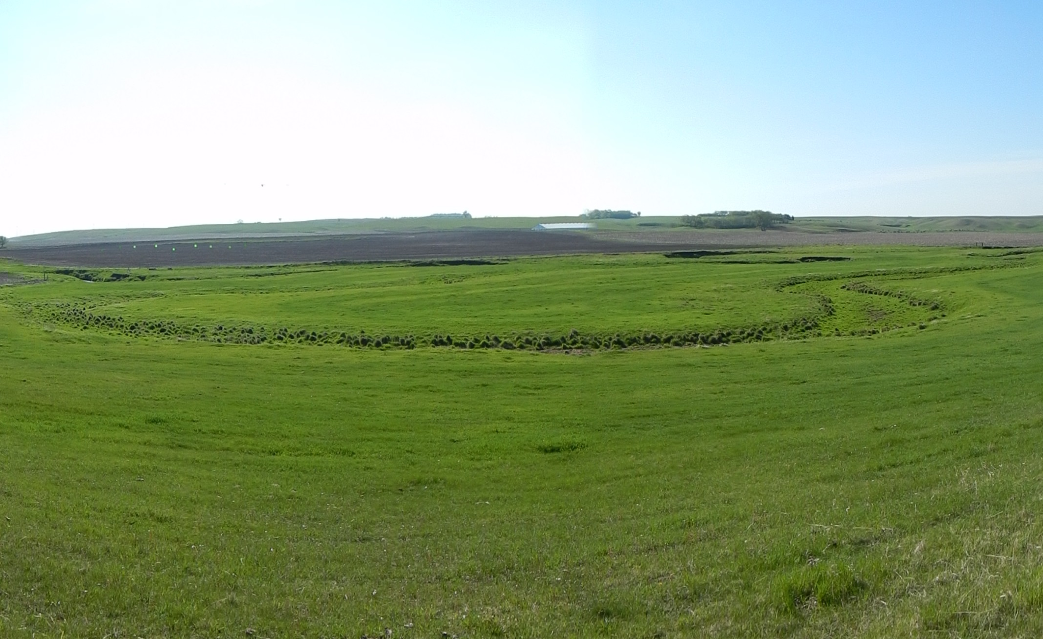
Site Selection
Using LIDAR and Air Photos in GIS, manually identified potential oxbow in Topeka shiner critical habitat in MN. Nearly 900 stream miles, identified over 1,200 sites
Developed scoring system with input from FWS, DNR and SWCD’s
Proximity to recorded Topeka Shiner sightings
FWS ES Resiliency Model Ranking
Land use (idle, grazed, hayed)
Protection status (Conservation Easements or Fee Title)
Stream Type (small upper reaches)
Depth to ground water
Depth of excavation (cost)
Stream stability
Willing landowners

Slide 9
Avoid Causing Channel Shifts
Excavating oxbows here may encourage a
new stream cut-off

Slide 10
Protected Inside Curves are good
Flow Direction
Outer Curves are okay if set back farther
Flow Direction
Avoid an entrance where direct head flow will enter

Slide 11
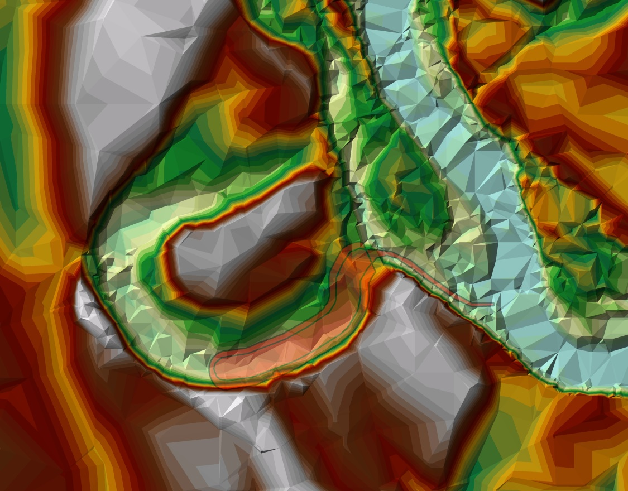
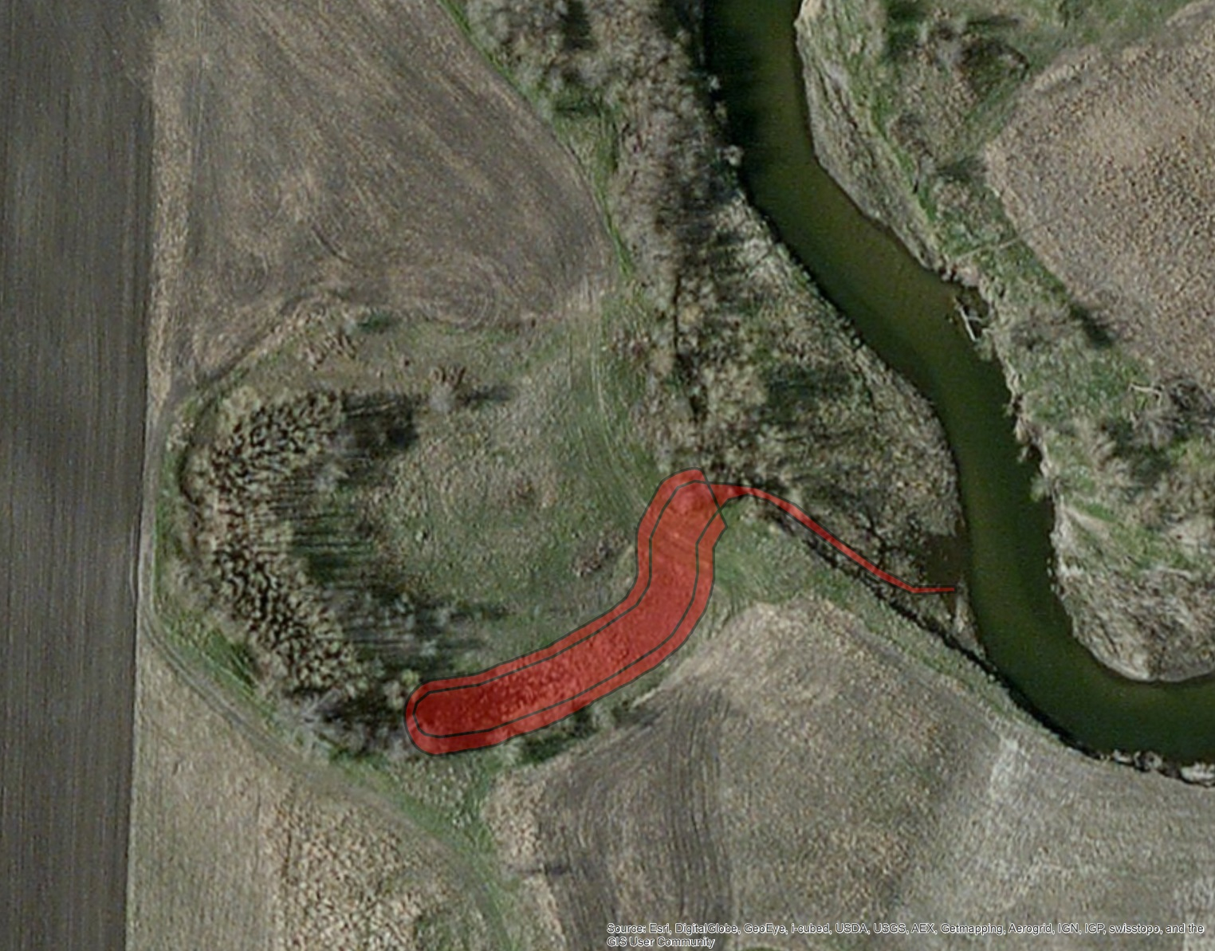
¼ acre or smaller, not whole oxbow
Predators avoid smaller pools
Avoid tree overhang;
leaf litter in pools decays causing low O2
Narrow downstream oriented entrance/exit. Backing water only
Connect downstream side only. Avoid flow through

Slide 12
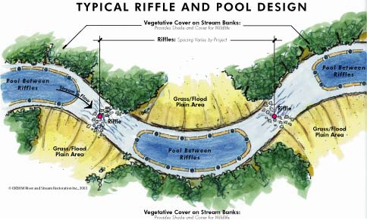
Measure depth of pools, bankfull & low flow elevations

Slide 13
Oxbow Construction for Topeka Shiners
Entrance length usually at least 30ft long or at least past natural bank levies or major flood flow path;
about ¼ channel width
Bankfull/Floodplain Elevation
Cut entrance between bankfull & low flow
Low Flow
Elevation
Oxbow bottom same as adjacent deepest pool elevation.
Width = to channel

Slide 14
Restorations to Date (End of 2017)
40 Different Landowners/Partners
64 Oxbows
2 Stream Remeanders (2,700ft)
2 Dam Removals (40 miles of new connection)
1 Floodplain Connection Improvement
1 Bridge/Crossing Improvement
5 Interpretive/Educational Kiosks
5 Stream Grade Control Riffles
3 Wetland Restoration in the Watershed (24 acres)
4 Streambank Stabilizations
2 habitat Easements (280 Acres)
12 Buffers or Upland Watershed Seedings (240 acres)

Slide 15
Site Protection Status
Of 104 Completed projects
14 on Federal Owned Land (13%)
13 on USFWS Easement (13%)
6 on State DNR land (6%)
9 other non-FWS Easements (9%)
37 Protected by State Waters Law (35%)
19 Under Temporary Easement (CRP) (18%)
Remaining 6 have 10 year landowner agreement (6%)

Slide 16
Financials
102 Project Completed
$1,548,005 Total project Expenses
$720,773 from Initial CRI Grant (46%)
$415,771 from other Federal Funds (27%)
$411,461 from non-federal partners (State, County & Private landowners) (27%)
Approximately 1,000 staff days.
2 Habitat Easements (280 acres), $402,575
(Not counted above)

Slide 17
Pre & Post Monitoring

Slide 18
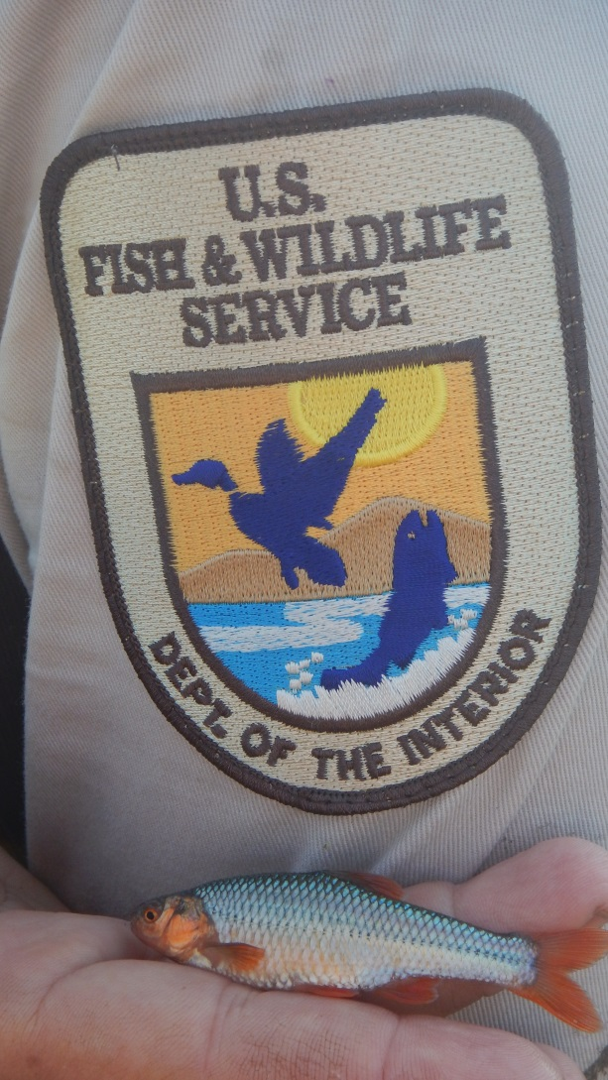
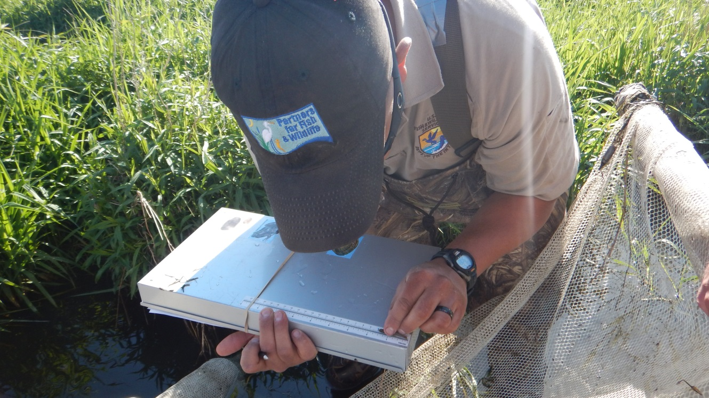
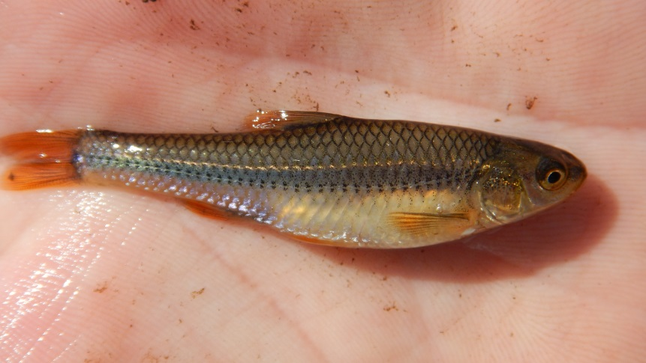
Look what we found!

Slide 19
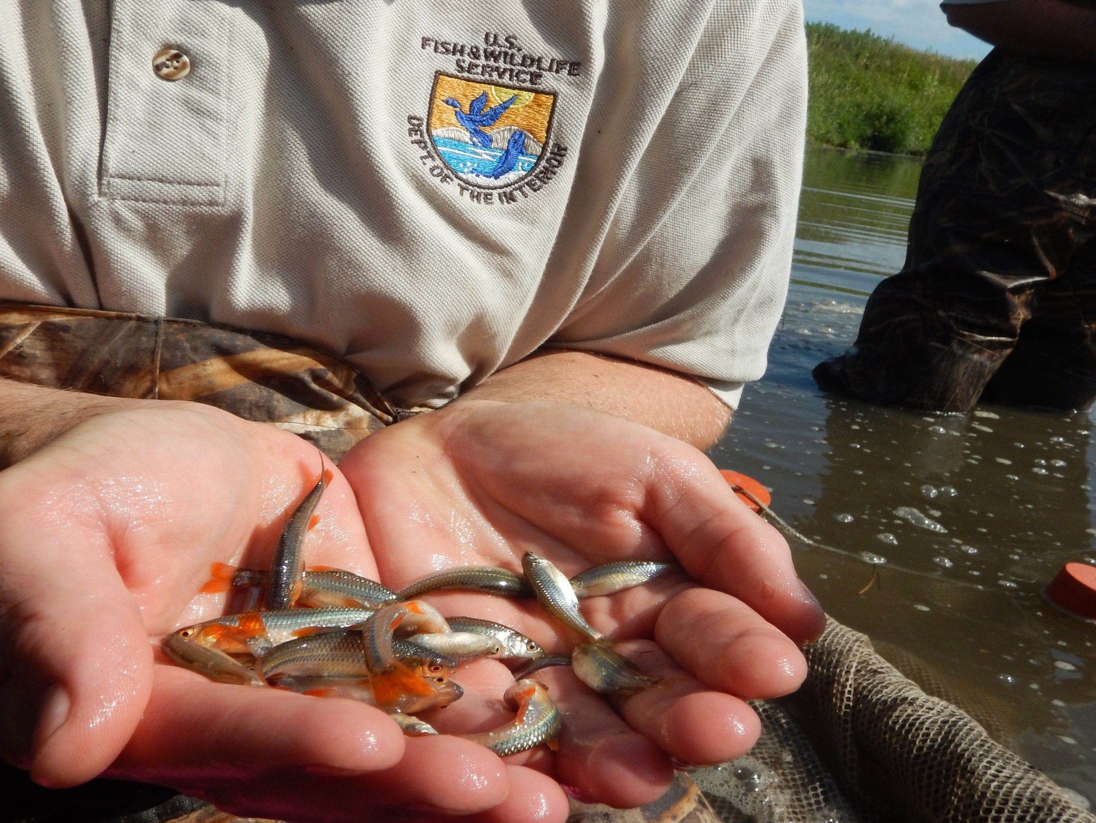
Oxbow Habitat Results (2017)
Pre & Post sampling results since 2015 (56 oxbows with Pre & Post Data)
Pre-restoration 44/56 (78%) sites with Topeka shiners found in the adjacent stream
Post-restoration 46/56 (82%) sites had Topeka shiners found in the adjacent stream
Pre-restoration 1/64 (1%) had TS found in unrestored oxbows (but not viable season long)
Post-restoration 38/56 (68%) oxbows had Topeka shiners in the oxbows & of that 36 had usage within 1 year post construction
Of the 18/56 that did not yet have TS found post construction 10 didn’t have TS in the stream yet and 3 had drain tile outlets*.
Very Few had any predators (like bullheads), in the restored oxbows and of that usually very low counts
31 species of fish found in the streams
29 species of fish found using the oxbows

Slide 20
*Tile In Oxbows - Observation
4 Oxbows with Tile Outlets
¾ have not had any Topeka shiner usage and very little fish usage of any species
1 that did have Topeka Shiners was a spring fed tile not much ag. drainage
Biggest water characteristic difference between tile vs non-tile oxbows was temperature averaging 5°C cooler in tile oxbows.

Slide 21
Other Benefits
Non-target species on State Threatened lists:
Plains topminnow (State Threatened) – Found in 9 Oxbows
Blanding's turtle (State Threatened)
Blanchard’s cricket frog (State Endangered)
Waterfowl
Shorebirds
General water quality Improvements
(Nitrates in oxbows are <1mg/L-N, In streams channels usually 6-13mg/L-N)

Slide 22
Future
Beginning a Phase II grant in 2018
Currently pending or in proposal (as of 2017)
59 oxbows
9 Wetland restorations
4 streambank stabilizations
2 dam removals
1 channel re-meander
2 habitat easements
Many more sites to pursue!

Slide 23
Example Projects

Slide 24
Flandreau Creek Channel Shift
Before
After
Partners:
DNR – Survey & Design
USFWS – Funding & Construction Oversight
Pipestone County – Funding & Construction
Private Landowner – Coordination/Cooperation

Slide 25
Flandreau Creek Channel Shift
Before

Slide 26
Flandreau Creek Channel Shift
After

Slide 27
Blue Mounds State Park Oxbow
Before
Partners:
USFWS – Survey, Design, Funding & Construction Oversight
DNR – Land Management & Design Consult, Funding (CPL)
Rock County – Coordination/Administration

Slide 28
Blue Mounds State Park
During

Slide 29
Blue Mounds State Park Oxbow
After

Slide 30
Huisken Stream & Oxbow Restoration
Partners:
USFWS – Survey, Design, Funding & Construction Oversight
DNR – Survey, Design, Funding (SWG)
Rock County – Coordination/Administration
Landowner – Coordination/Cooperation

Slide 31
Huisken Stream Remeander
Before

Slide 32
Stream Remeander
Before

Slide 33
Huisken Stream Remeander
During

Slide 34
Huisken Stream Remeander
After

Slide 35
Huisken Floodplain Flow
Before

Slide 36
Culvert Filled with Sediment Due to Over Wide Channel and Low Sediment Transport Capacity

Slide 37
Huisken Floodplain Flow
During

Slide 38
Huisken Floodplain Flow
After

Slide 39
Pipestone WMA Coordination Area
Dam Removal
Partners:
USFWS – Survey, Design, Funding & Construction Oversight
DNR –Design Consult, Funding (CPL), Site Management
Pipestone County – Coordination/Administration

Slide 40
Pipestone Indian Lake Dam
Before

Slide 41
Pipestone Indian Lake Dam
Before

Slide 42
Pipestone Indian Lake Dam
After

Slide 43
Interpretive Kiosk Developed

Slide 44
Pipestone Indian Lake Dam
Interpretive Kiosk

Slide 45
Adrian Dam Removal
Partners:
USFWS – Design, Funding & Construction Oversight
DNR – Geomorph Survey & Design Consult
Nobles County – Coordination/Administration
Private Landowner – Coordination/Cooperation

Slide 46
Adrian Dam
Before

Slide 47
Adrian Dam
Geomorph Survey

Slide 48
Adrian Dam
During

Slide 49
Adrian Dam
After

Slide 50
Poplar Creek WMA Oxbows
Partners:
USFWS – Survey, Design, Funding & Construction Oversight
DNR –Design Consult, Funding (CPL), Site Management
Pipestone County – Coordination/Administration

Slide 51
Poplar Creek WMA
Before

Slide 52
Poplar Creek WMA
After

Slide 53
Streambank Stabilization
Before
Partners:
USFWS – Design, Funding & Construction Oversight
DNR –Design Consult, Funding (CPL)
Rock County – Coordination/Administration
Private Landowner – Coordination/Cooperation

Slide 54
Streambank Stabilization
After

Slide 55
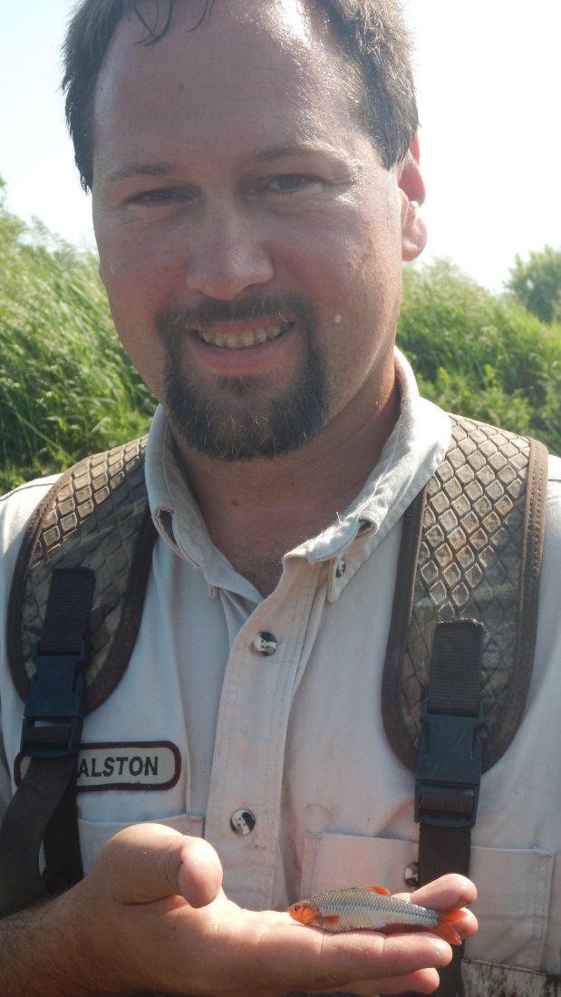
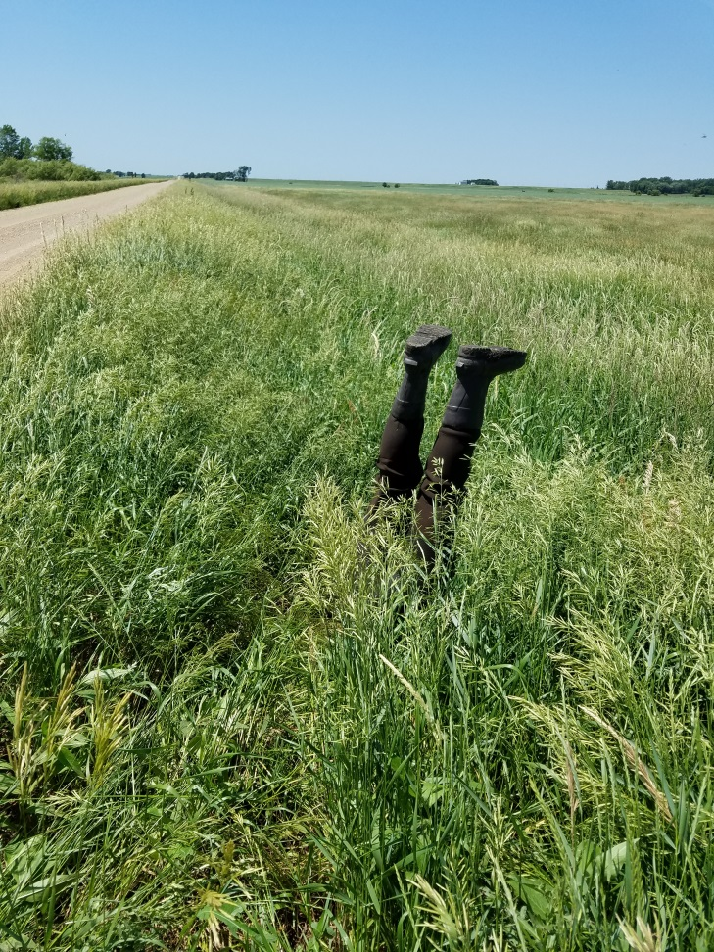
Thank You!
This Presentation Available to Download
http://skralston.com/USFWS/

