Slide 1
Habitat Restoration GIS Review
Scott Ralston – PFW Wildlife Biologist
USFWS, Windom MN
Tutorials here: http://skralston.com/USFWS/
March 2024

Slide 2
Detailed Step-by-step Resources

Slide 3
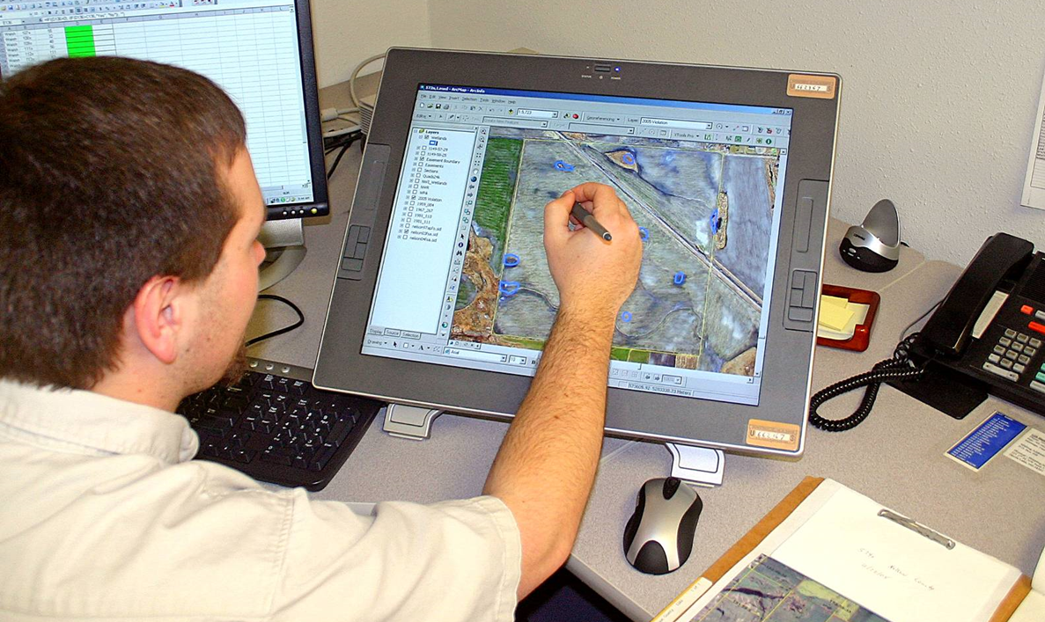
Desktop Site Review Purpose
Efficient
Determine if field visit is even needed.
Able to target questions or concerns with more knowledge of the site to review with landowner.
Identify areas you need to focus on in field visit
Identify feature may not see on the ground
Historic landuse changes, soil maps, biological records, easement or ownership interests, drainage

Slide 4
Gather data layers
Tutorials here http://skralston.com/USFWS/
ArcPro tutorial has many data sources for MN listed.
Create a template map so you don’t have to recreate every time you have a new project. Preload with everything needed.
Utilize AGOL data when possible. Many online sources.

Slide 5
Air photos
As many years as possible
See changes through time
Specific years when a change was made
Wet and dry cycles or seasons change visibility or show minimum or maximum extent of water
Large scale mapping

Slide 6
Newest photos usually MAXAR Digital Globe Satellite. Need account using .GOV email.

Slide 7
Oldest usually 1930’s (About 4mi^2)

Slide 8
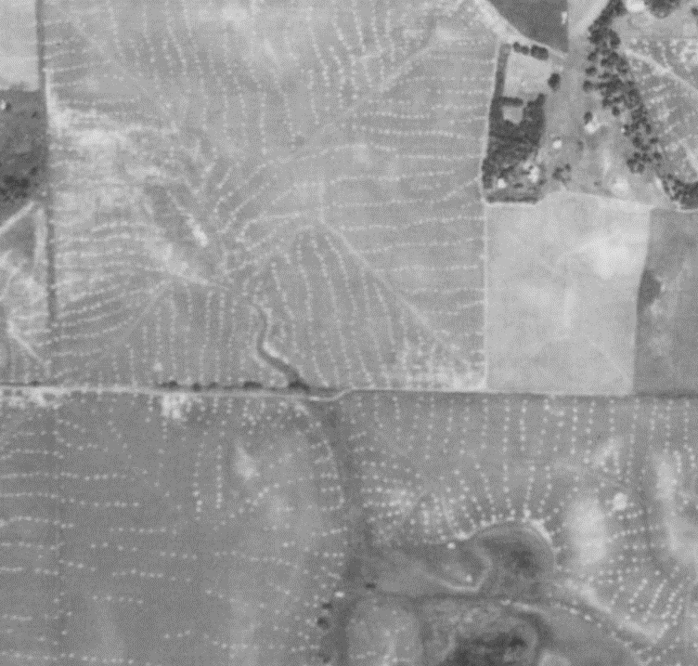
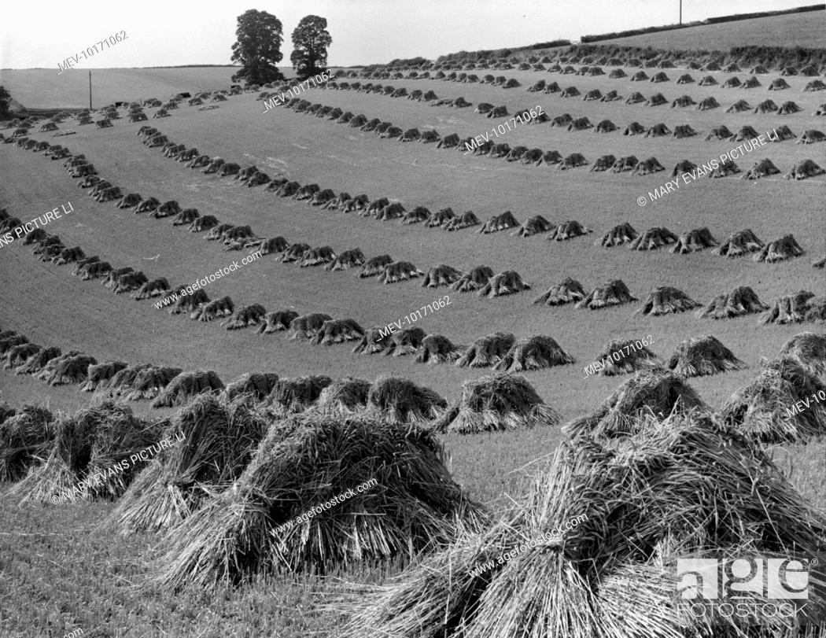
Air Photo Interpretation Think from a ground perspective

Slide 9
FSA Compliance Photos 1980-2000 (1mi^2). Mixed CIR & color.

Slide 10
NAIP Early 2000’s to present about biannual. Available state/ regional/county

Slide 11
Original Plat Map Survey’s – 1800’s

Slide 12
Older Topo Maps 1950’s-60’s Use not for topo but older features

Slide 13
Soils – SSURGO Drainage & Hydric Class

Slide 14
NWI – National Wetlands Inventory

Slide 15
RWI – Restorable Wetlands Inventory

Slide 16
Public Waters Inventory – DNR Legal Jurisdiction

Slide 17
MN Biological Survey & Undisturbed Lands Layers for Native Prairie

Slide 18
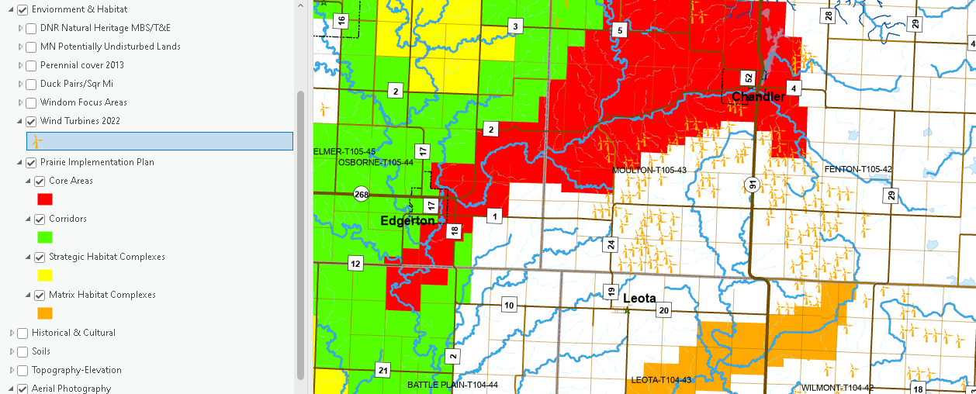
Focus Area Maps

Slide 19
Cultural Sites

Slide 20
T & E Data

Slide 21
County /Judicial Ditches - Legal Authority needed to modify

Slide 22
Land Ownership FWS, DNR, Easements, Etc.

Slide 23
Mapping wetlands with Lidar
Usually Map to Overflow

Slide 24
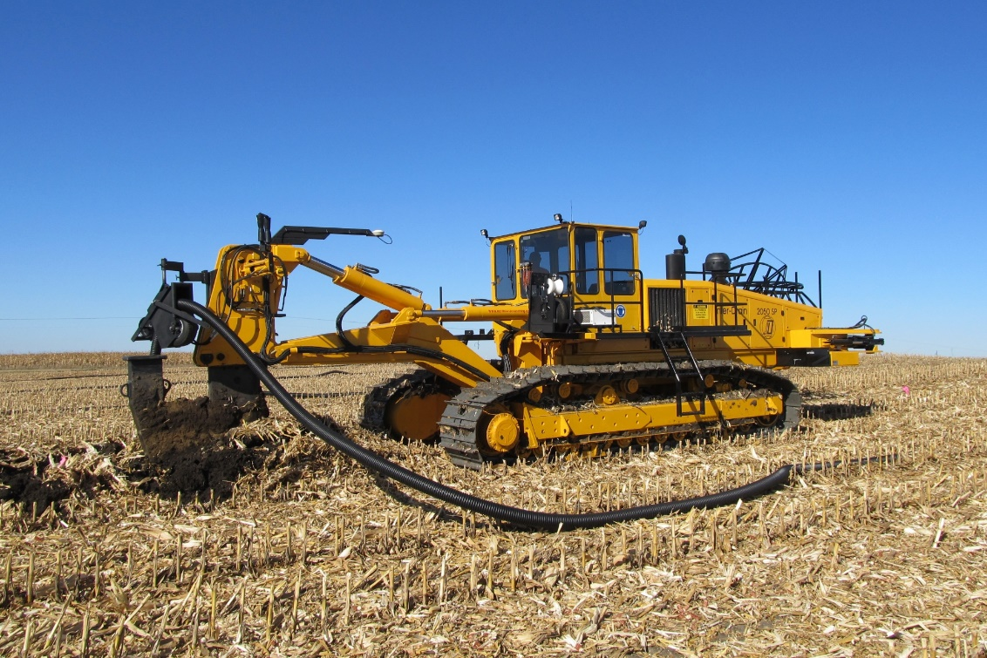
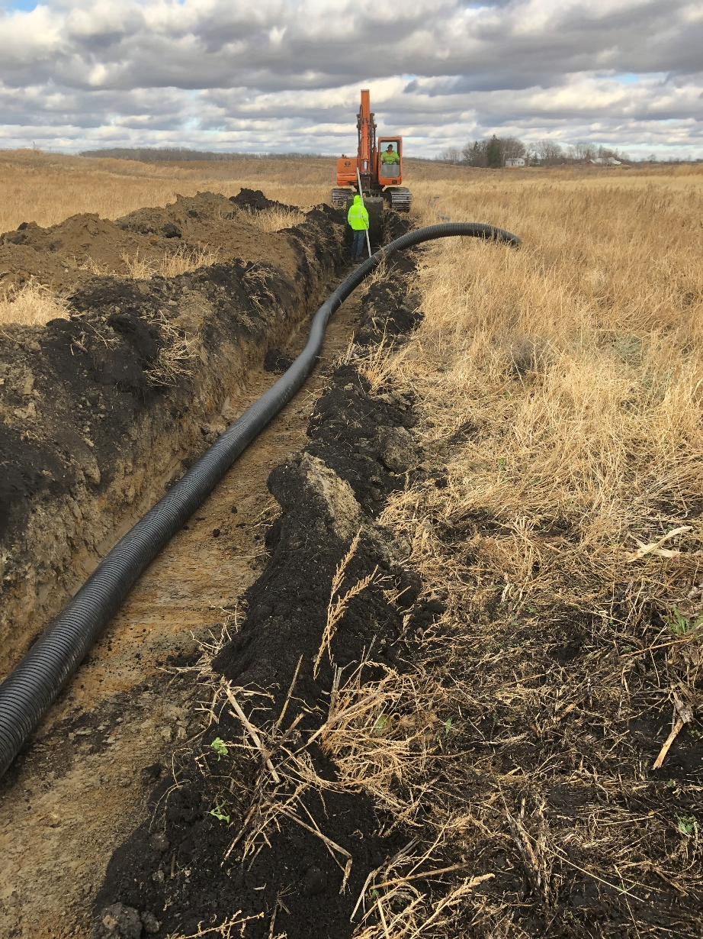
Methods of Installing tile
Tile Plow
Least Signature
Wheel Plow
Moderate Signature
Excavator Trench
Large Signature

Slide 25
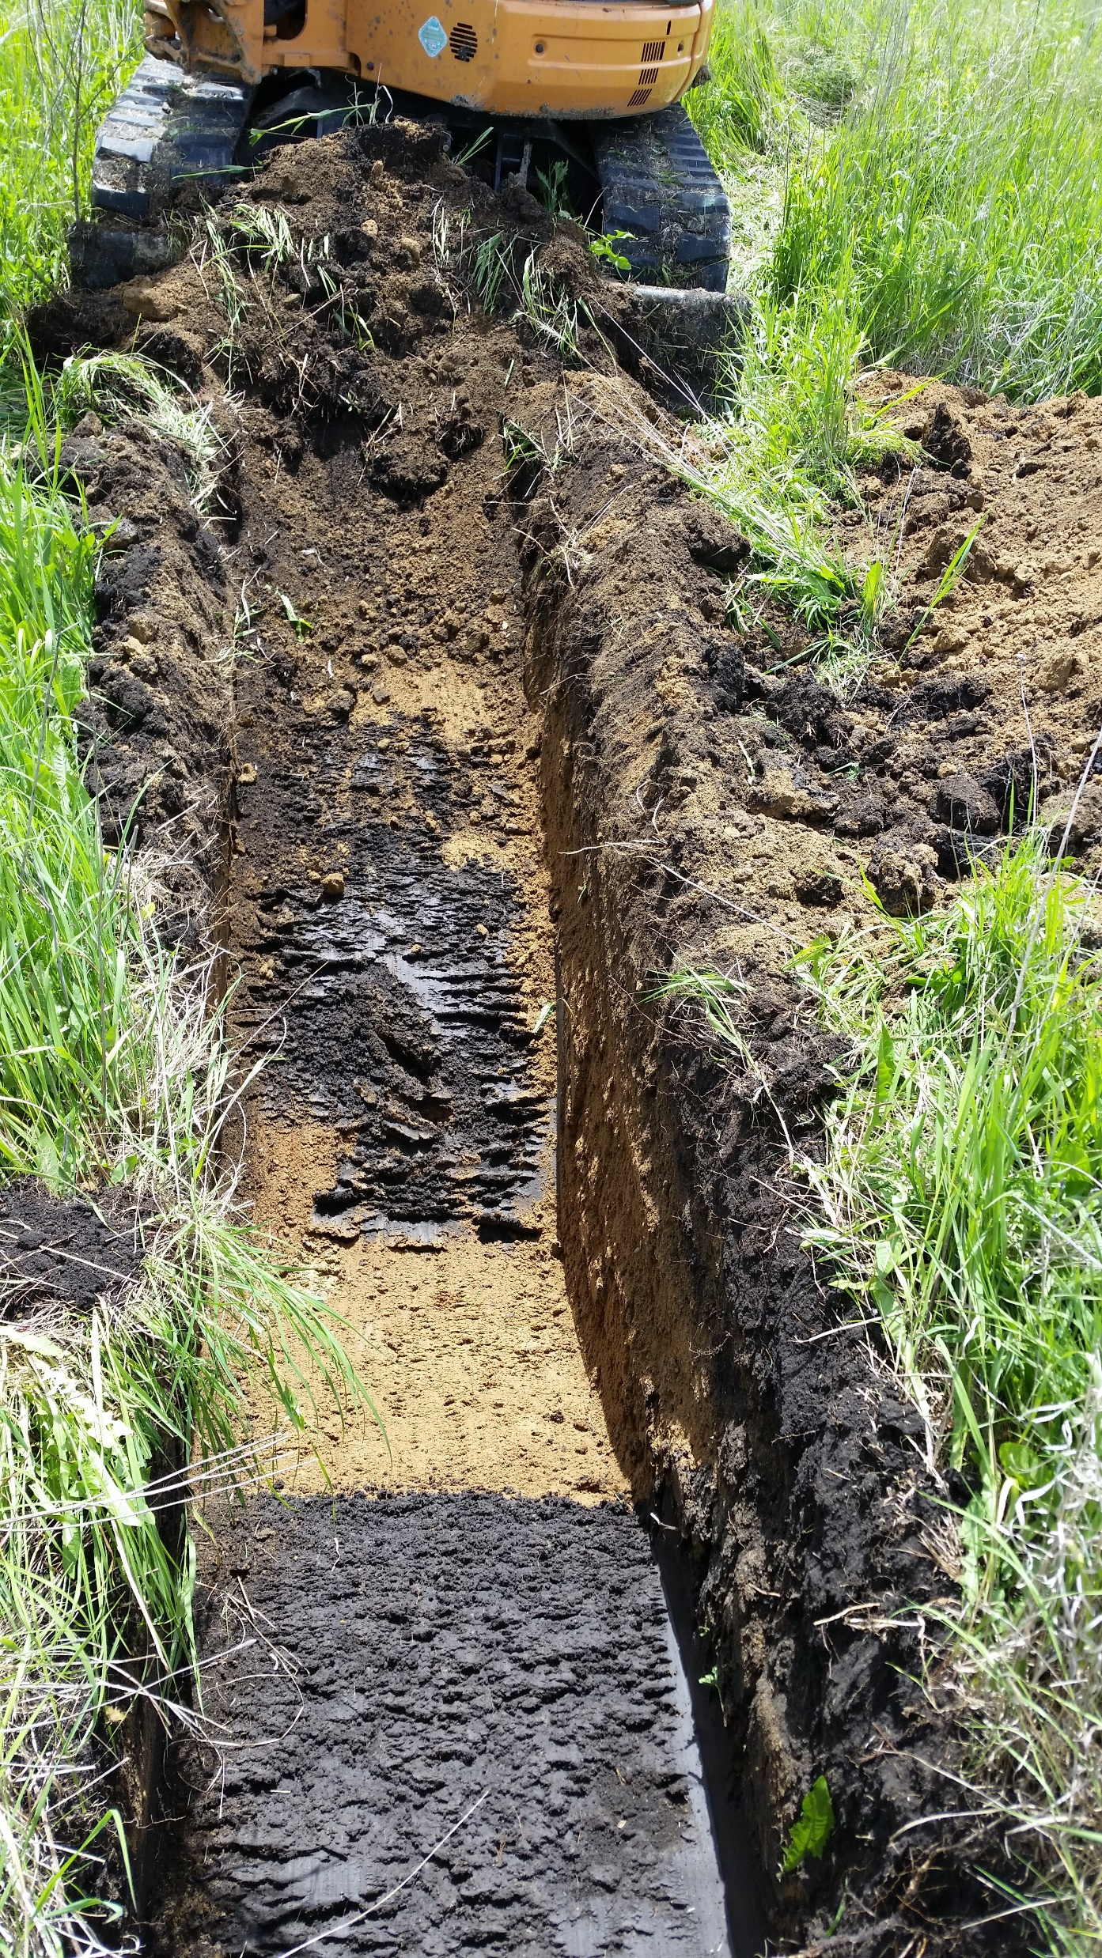
Tile Streaks

Slide 26
Tile Maps

Slide 27
Tile signature from NEW Installs

Slide 28
Old Tile Signatures
Lines

Slide 29
Old tile signatures
Lines

Slide 30
Finding Tile with Lidar

Slide 31
Tile Outlets from Lidar
Outlet Trench

Slide 32
Tile Outlets from Air Photos
Outlet Trench

Slide 33
Potential for Tile backup due to submerged outlet
Outlets here
Shallow here

Slide 34
Potential for Tile backup due to submerged outlet
Outlets here
Count contour lines
Shallow here
2-3ft at most
Minimum cover over tile about 2ft

Slide 35
Co-Owned basins. Backing water over a line
Enhancement back over the line here

Slide 36
Soils can impact restoration possibilities
Appears to have some hydrology

Slide 37
Soils can impact restoration possibilities
Has some topographic depression.
Can we enhance?

Slide 38
Soils can impact restoration possibilities
Sand/Gravel. Sediment removal could drain it

Slide 39
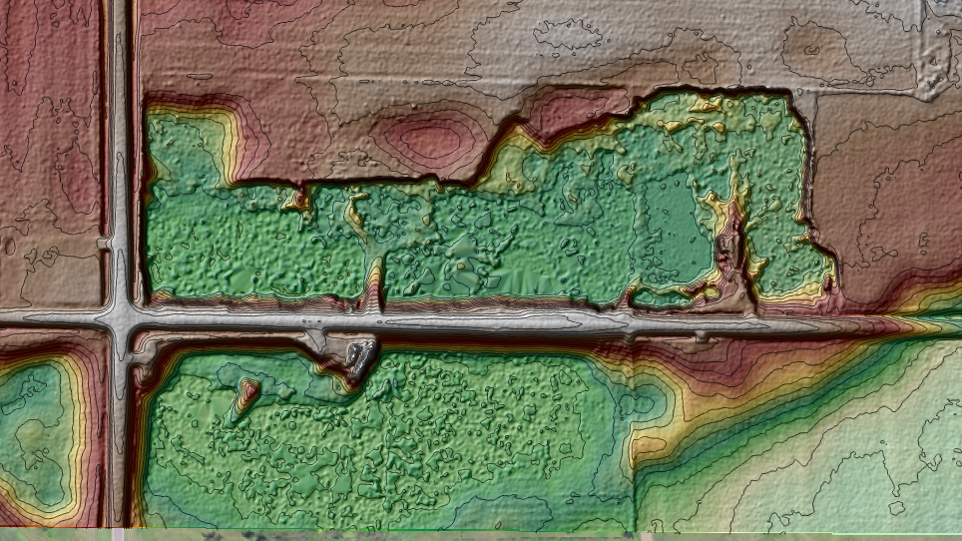
Groundwater level / Water table Influence -Water in gravel pit indicates water table
Water Table
Water Table

Slide 40
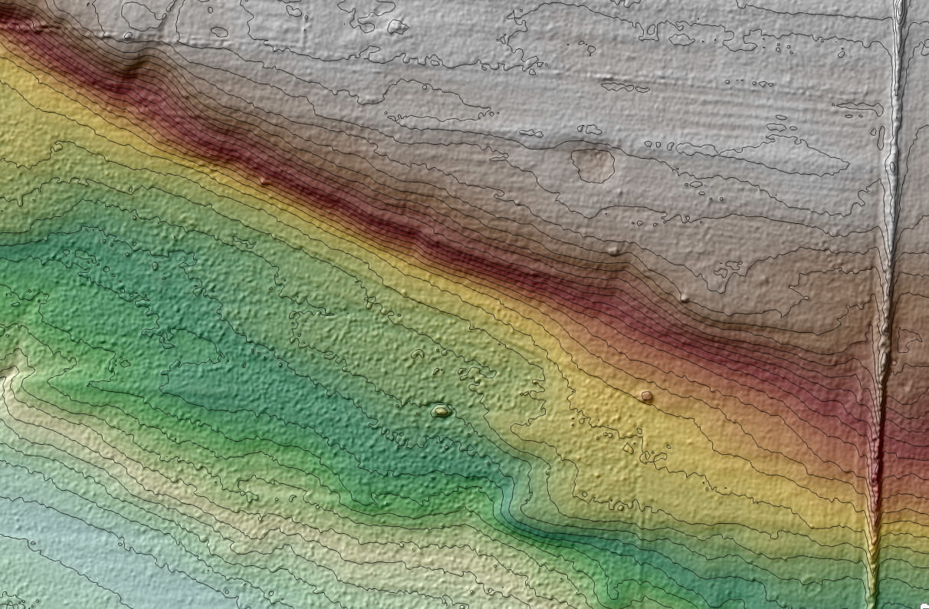
Potential Spring Seepage – Slope Wetlands Adjacent to steep slopes
Look for springs here
Look for springs here

Slide 41
Oxbows – Stream meander cut-off’s
Away from active channel migration

Slide 42
Oxbows – Stream meander cut-off’s
Away from active channel migration

Slide 43
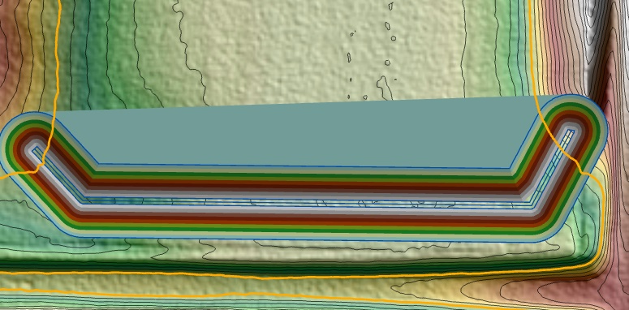
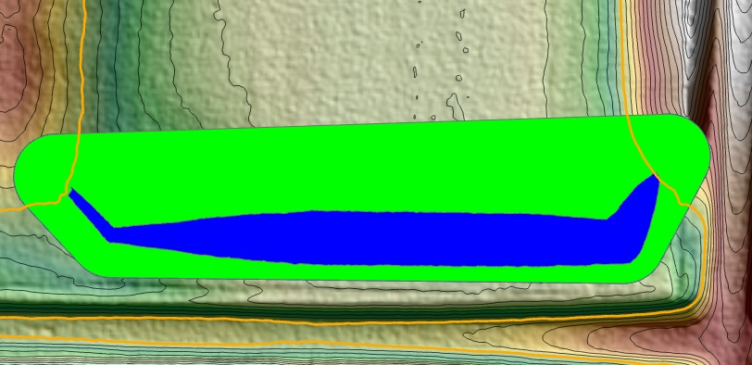
Cut/Fill Modeling – Dike Design

Slide 44
Dike Positioning
Bench
Road Separation
Traditional
Impoundment
Property line

Slide 45
Dike Positioning
Bench
Road Separation
Traditional
Impoundment
Property line

Slide 46
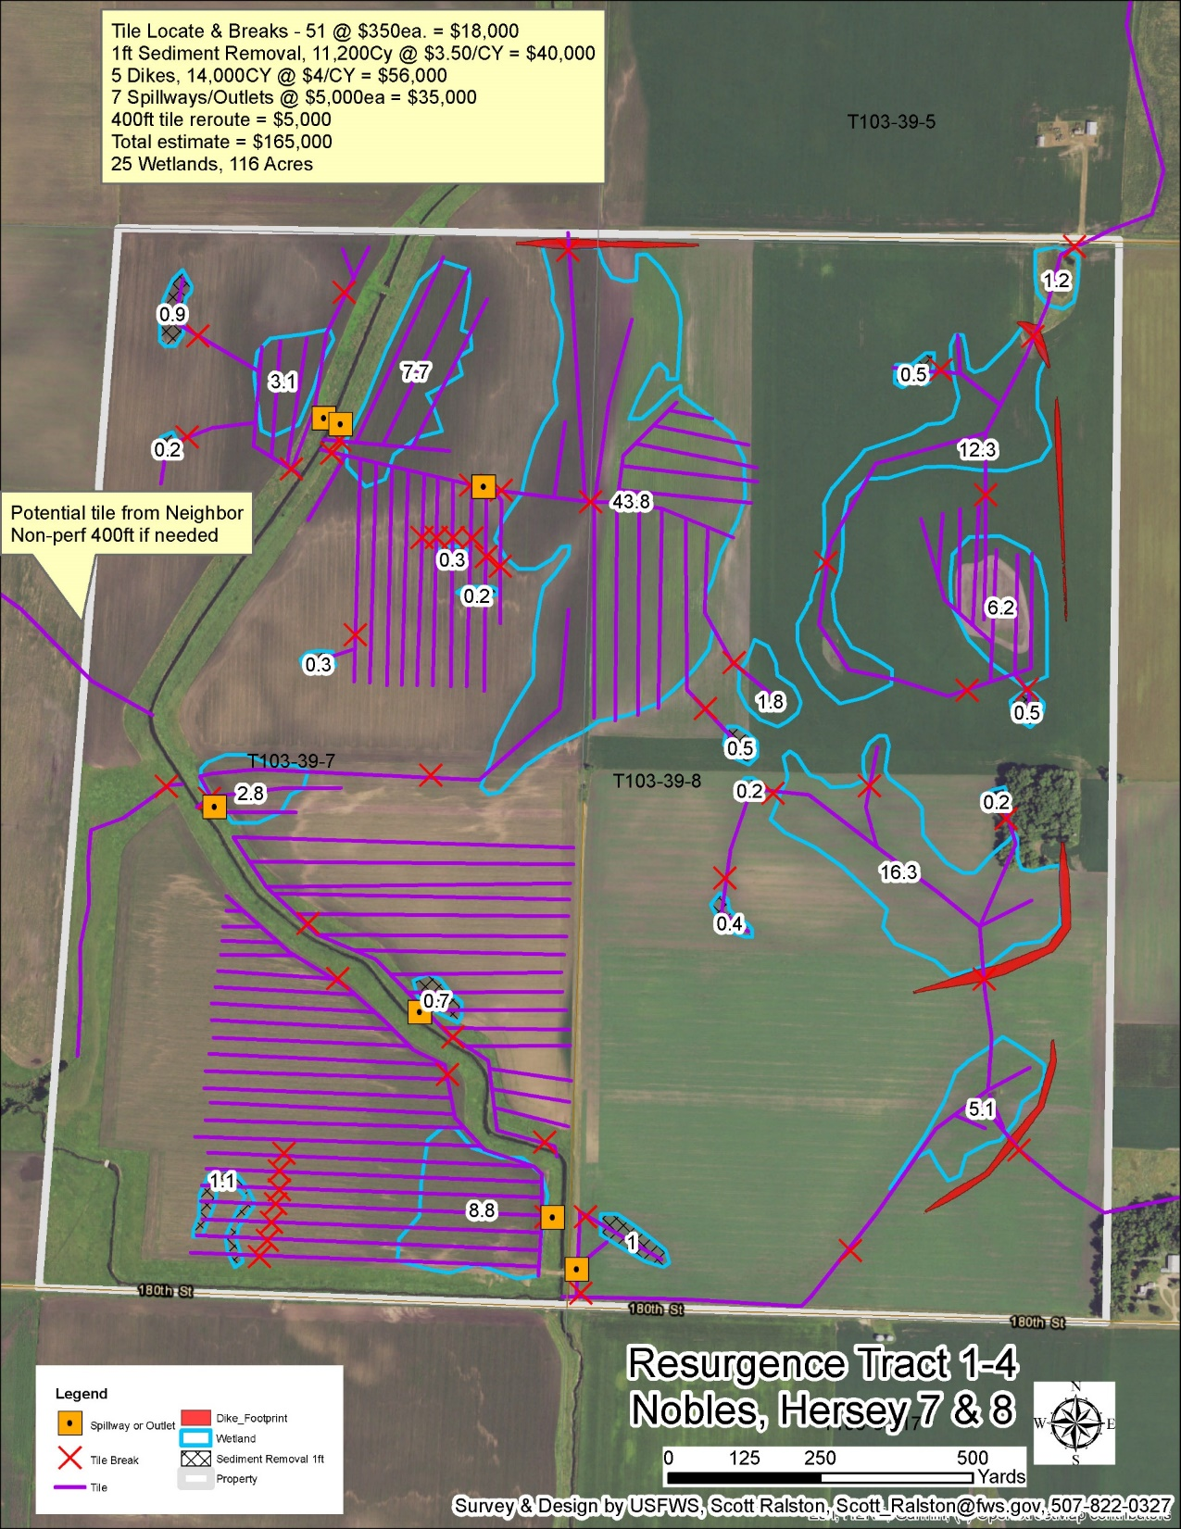
Map Products

Slide 47
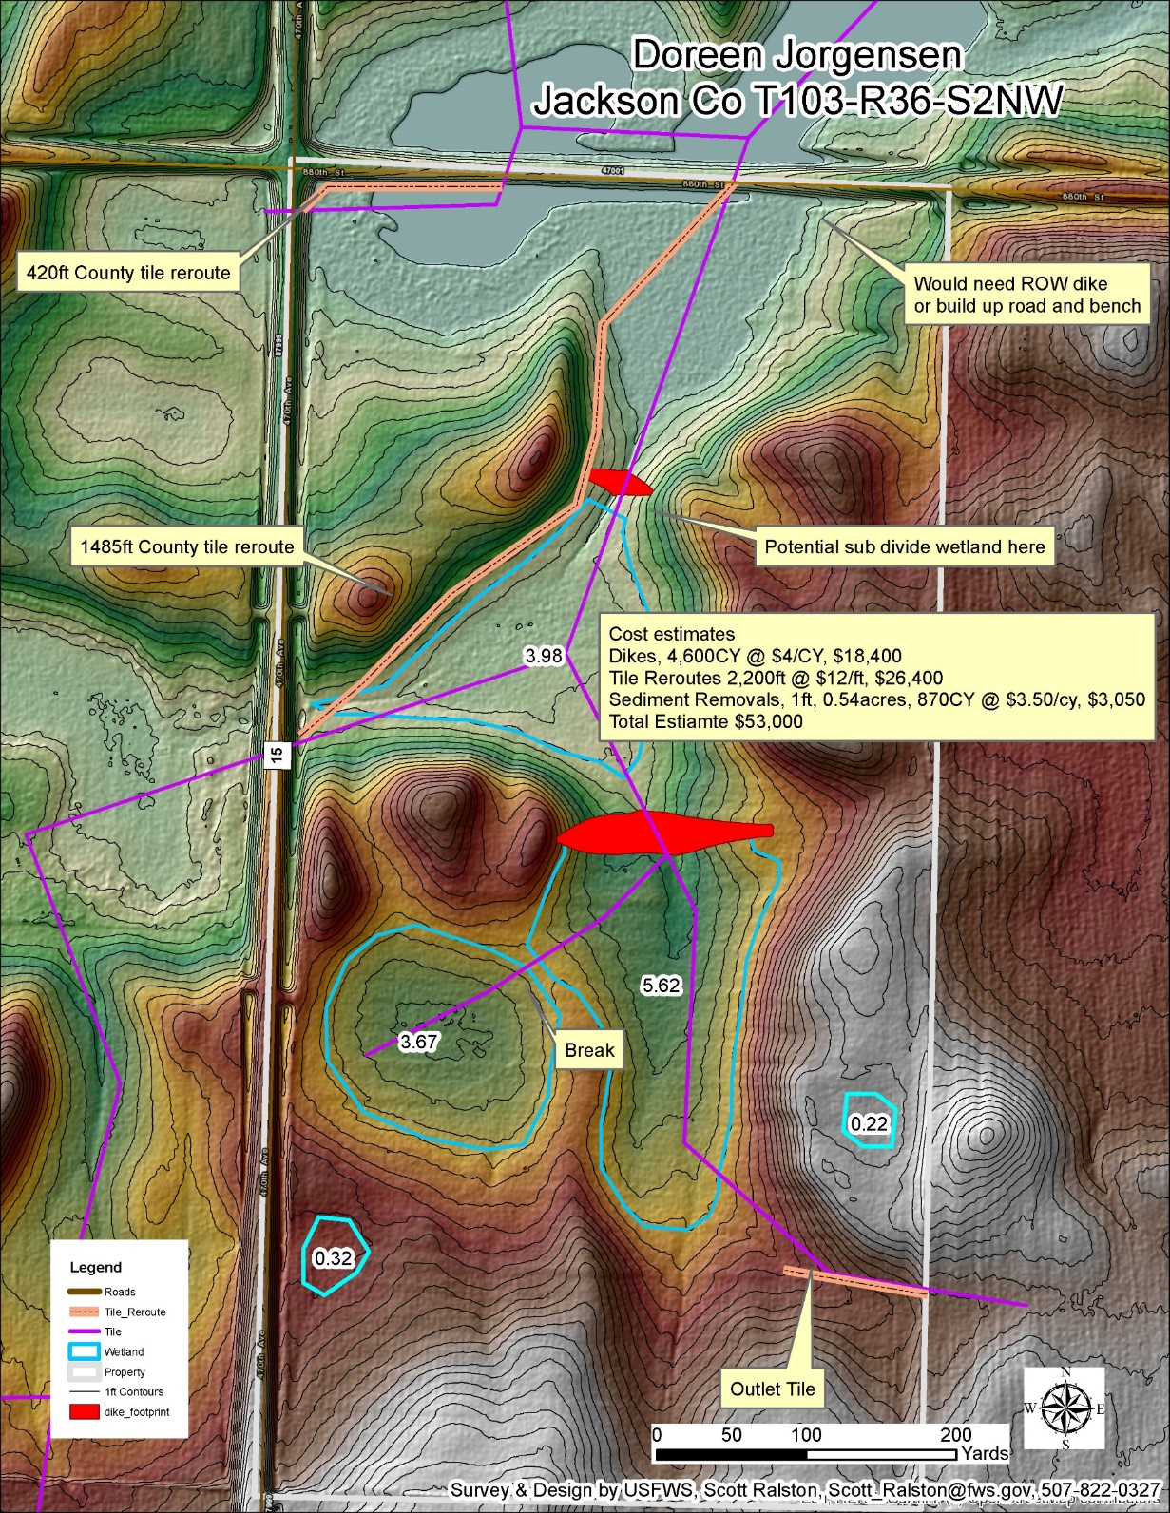
Map Products
Both Photos and Topo Helpful
Identify main features & Potentials
Acres Helpful
Cartographic Components
Title – Name & Location
Legend
Compass & Scale
Contact Info
Labels

Slide 48
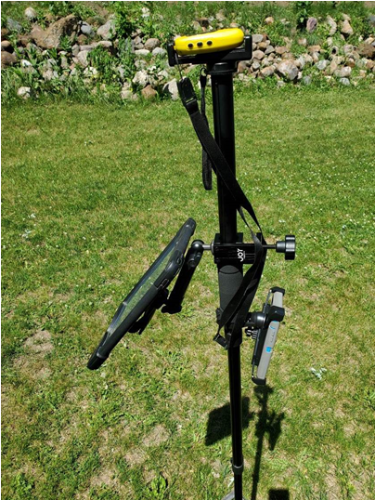
AGOL Database
Central Database
Available across multiple platforms
Multiple users simultaneous
Standardized collection
Control Permissions
Entire dataset available at any time anywhere
Streamlines Office and Field integration

Slide 49
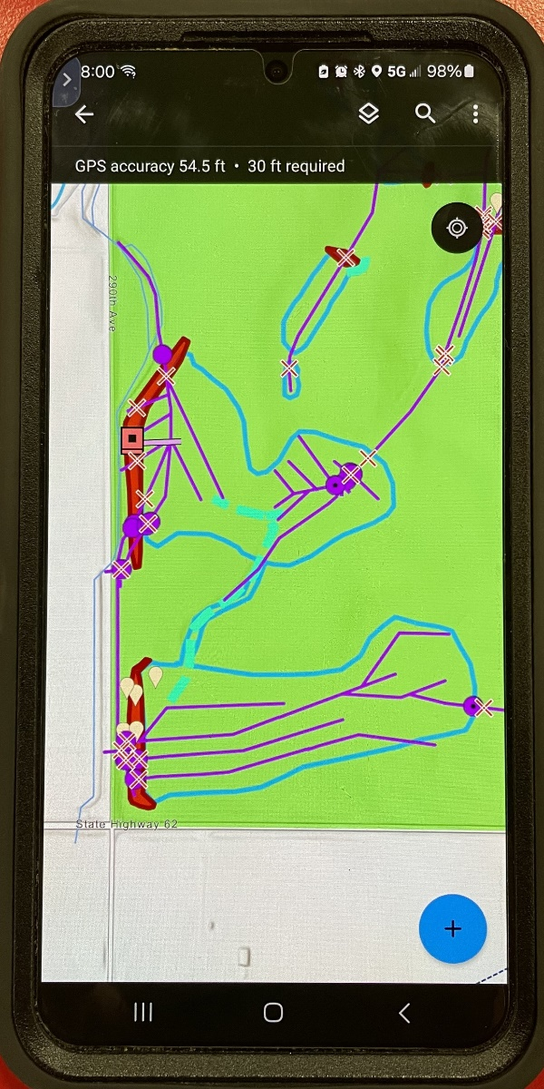
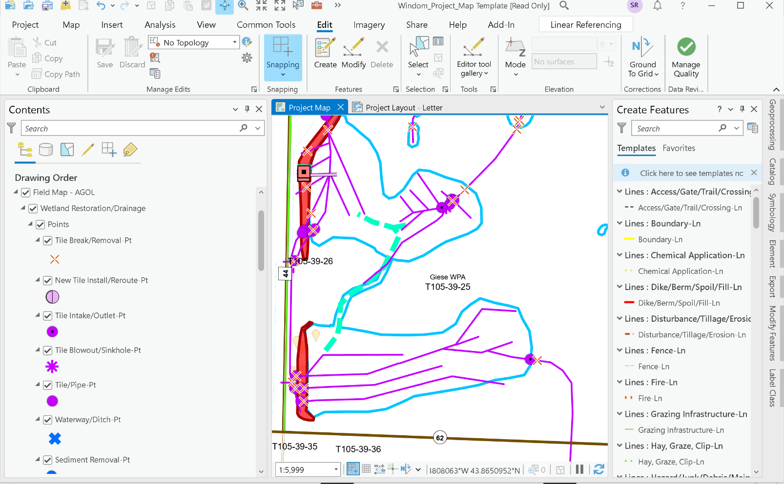
AGOL Platforms

Slide 50
Use Learning Resources!

Slide 51
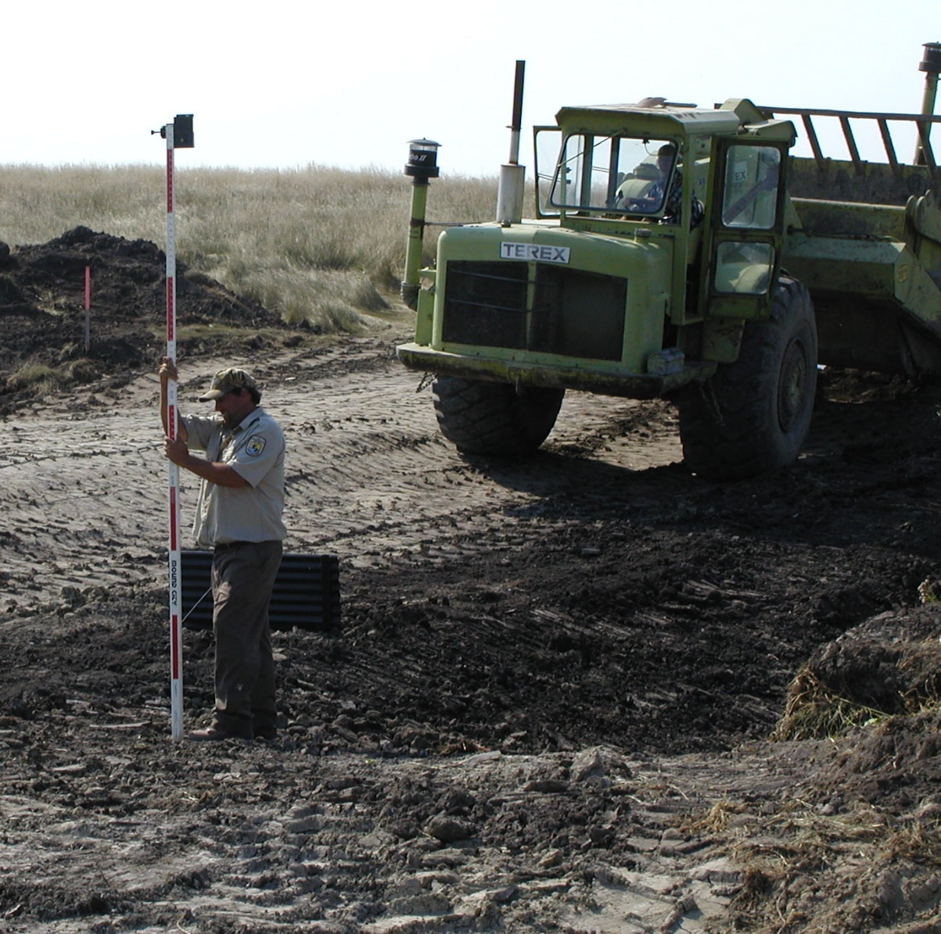
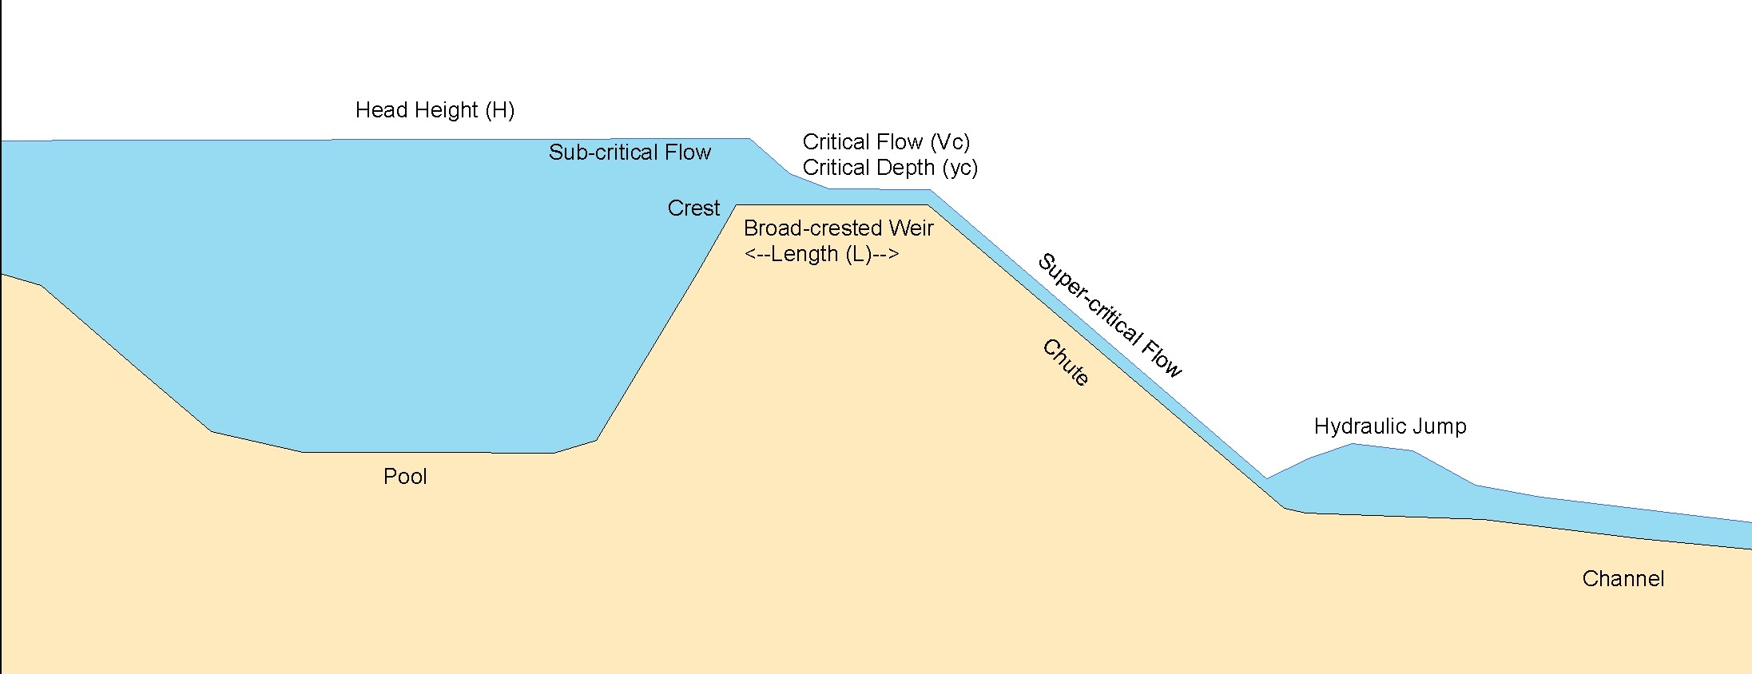
Wetland Design
Design can get complicated. More than a short presentation can offer.
Biologist become Engineers
Job Shadow & Review Previous Work
Always consider liability first. Design within your comfort.
Where will water go either in outlet or ponding area? Impacts?
If in doubt, overbuild.

Slide 52
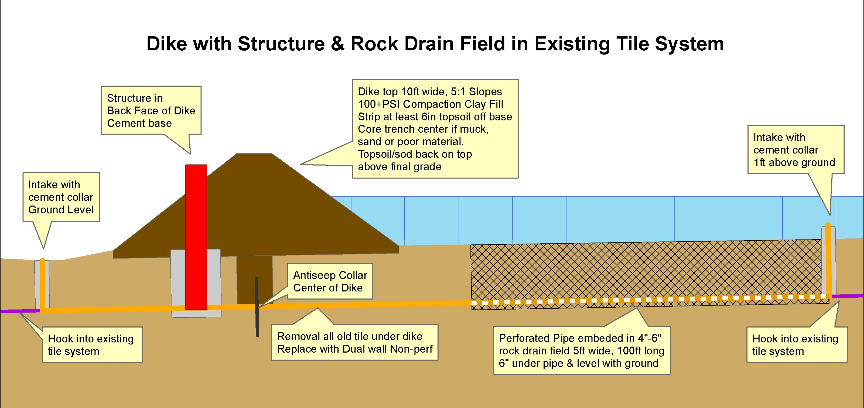
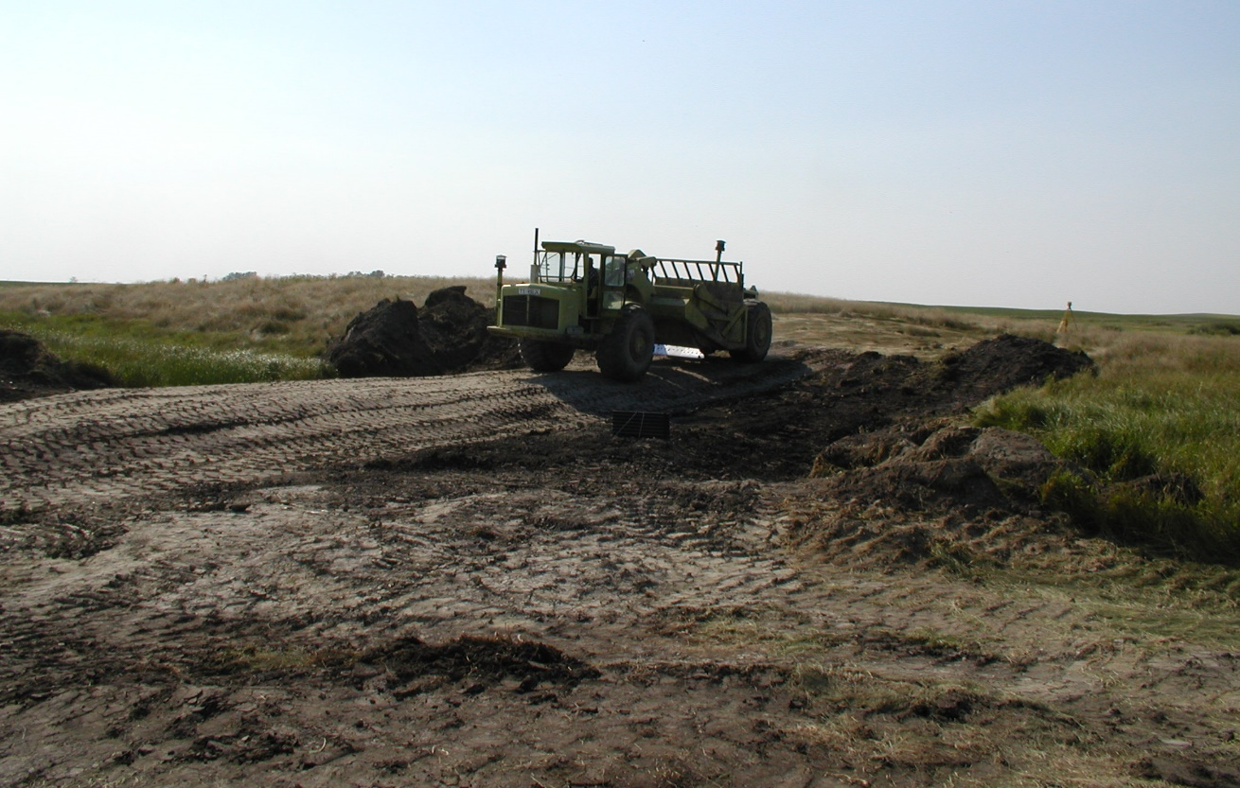
Construction Standards/Minimums
Ditch Plug
Minimum 30ft fill length.
Always opt for complete ditch fill if possible
Dikes
10ft top 5:1 slopes minimum
100psi compaction
Strip sod base & core trench if soft.
Clay fill
Spillways/Outlets
Variable depending on watershed
Follow hydraulic flow formulas
Some may require armor some may not.

Slide 53
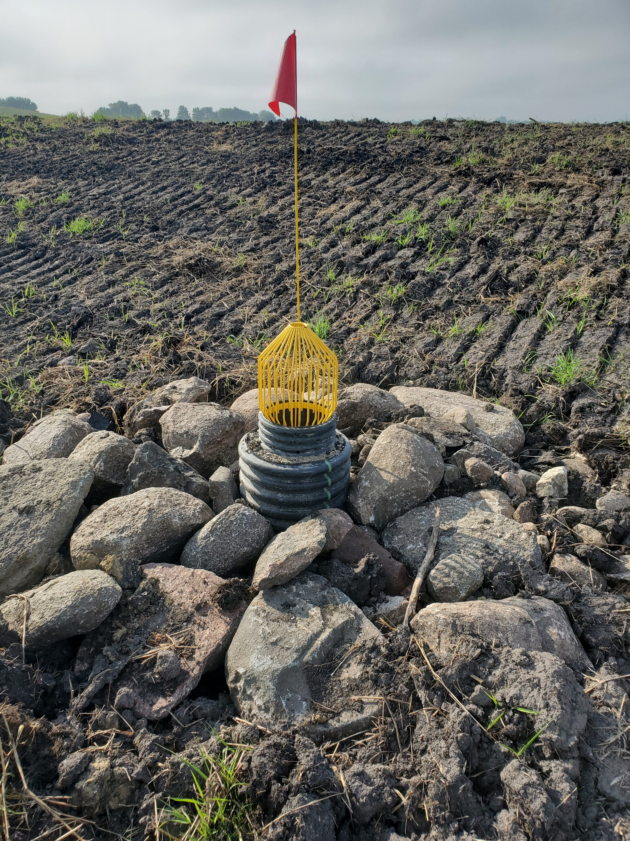
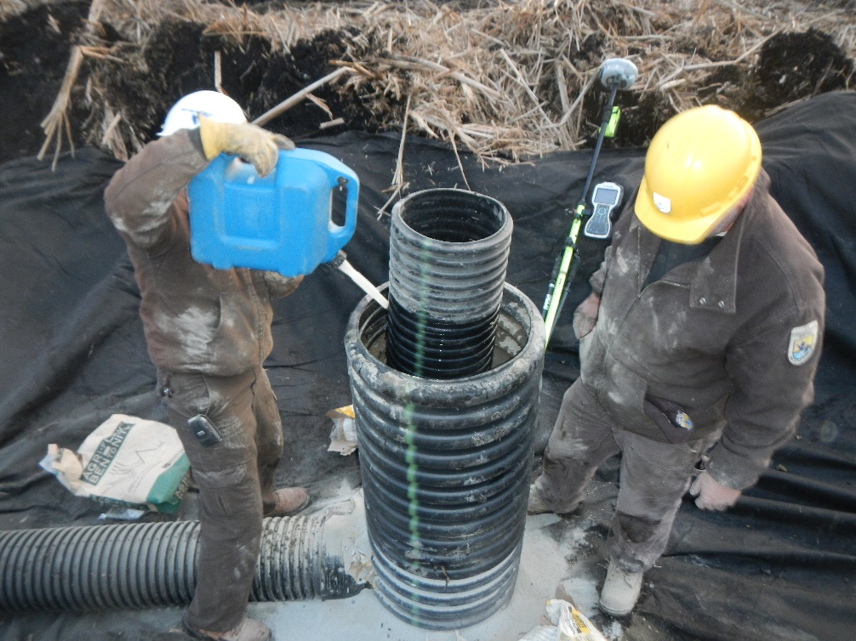
Construction Standards/Minimums
Tile breaks/removals
Minimum 100ft
Plastic remove from trench. Hard tile thoroughly crush & mix
Plug ends
Tile Replacement/Reroute/Install
Non-perf unless specifically need perforation
Dual wall wherever possible
Gasketed/sealed joints
Minimum 2ft of cover
Fireproof/Tamperproof Intakes & Outlets.

Slide 54
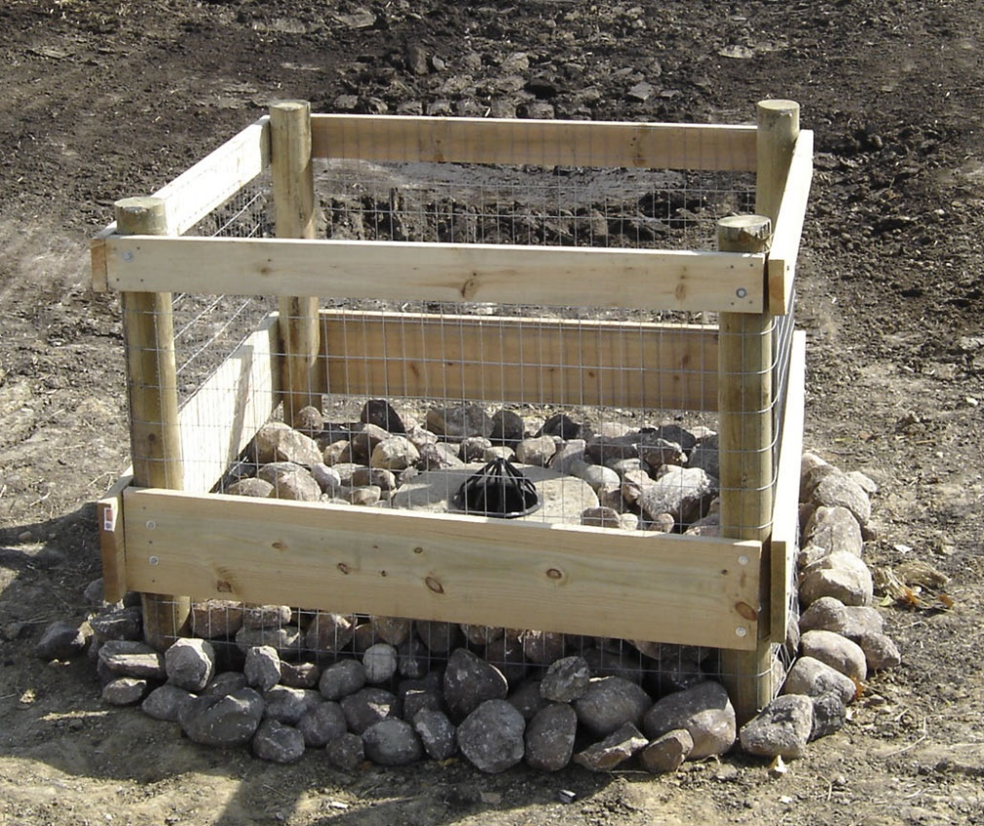
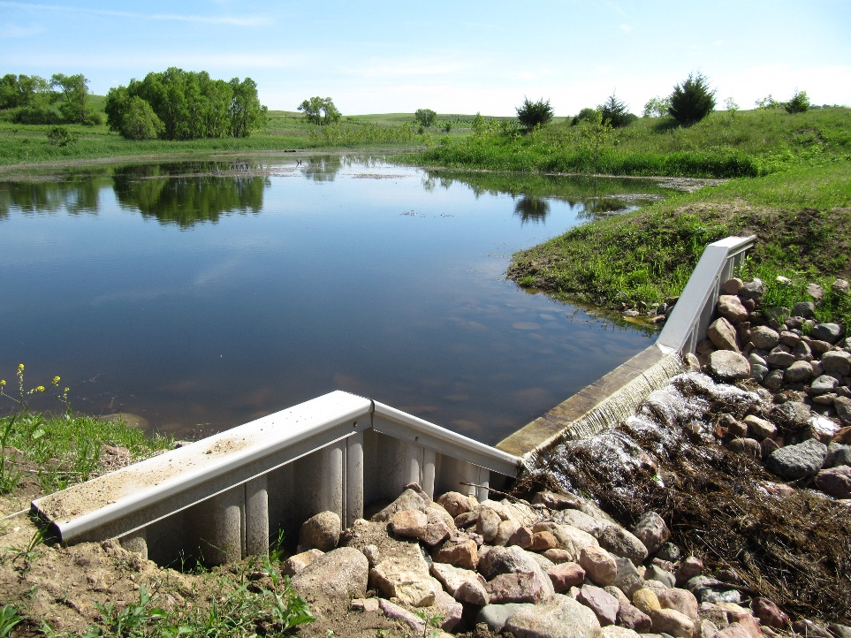
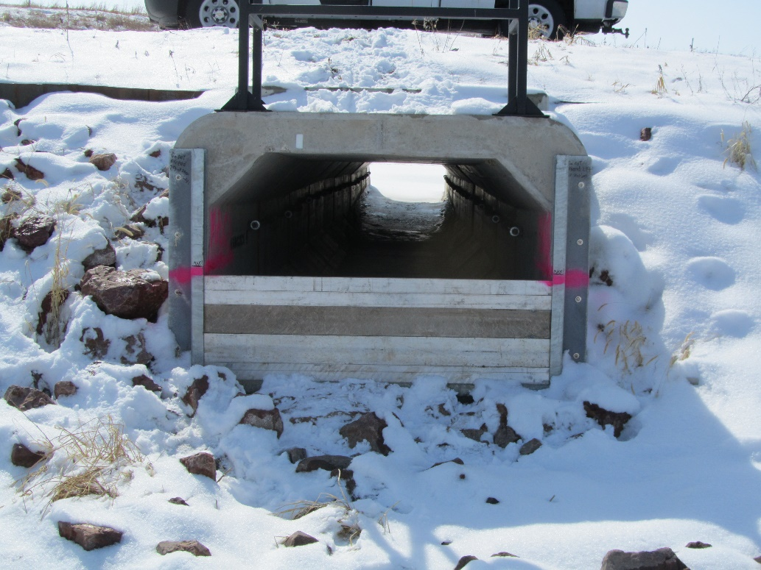
Construction Standards/Minimums
Structures
Variable crest only where appropriate. Who controls? Is it necessary? Who maintains?
All structures use longest term, least maintenance design possible. Open spillways, easy access, greatest capacity.

