Slide 1
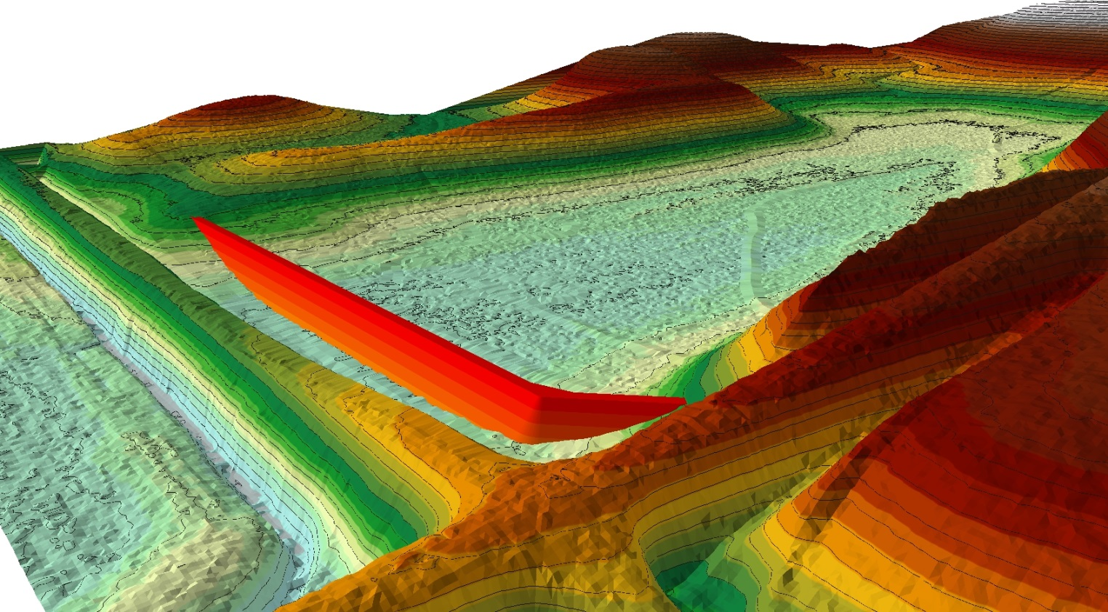
Using ArcGIS to Design Wetland Restorations By Scott Ralston, USFWS Windom, MN
Available for Download from: SKRalston.com/USFWS/

Slide 2
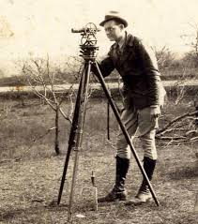
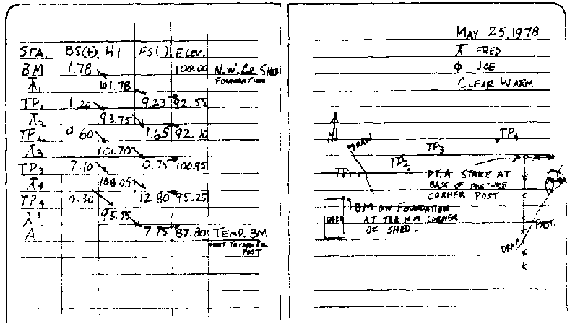
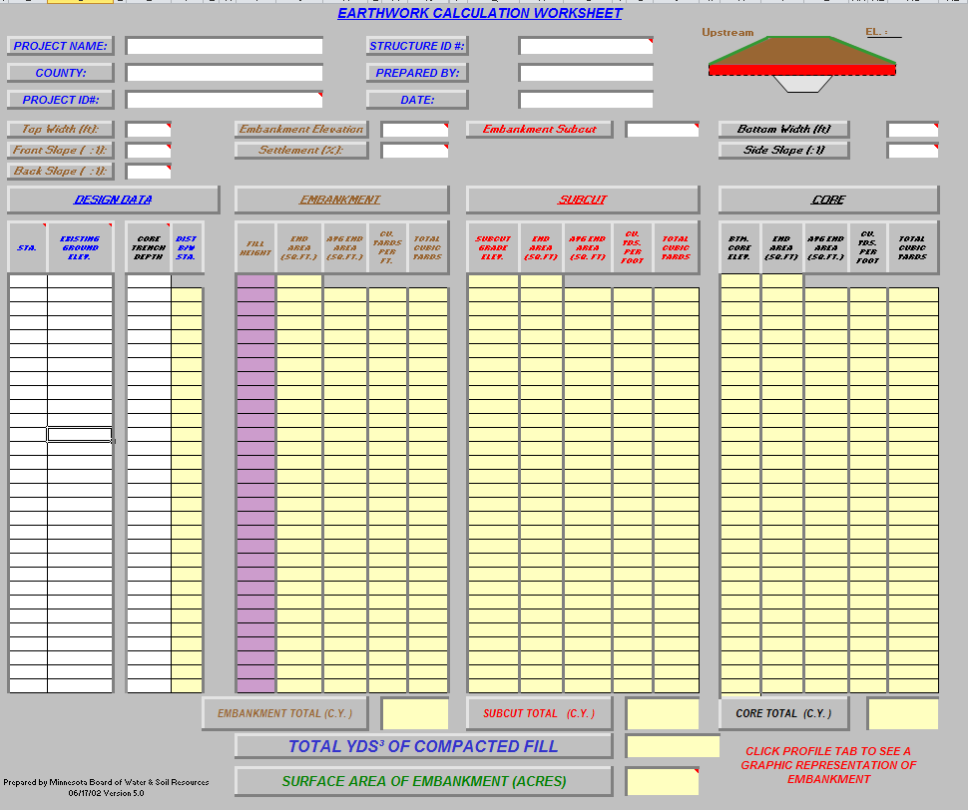
How many still use this?

Slide 3
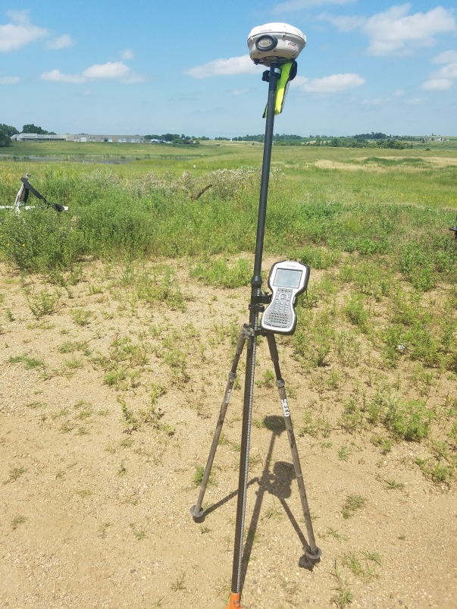
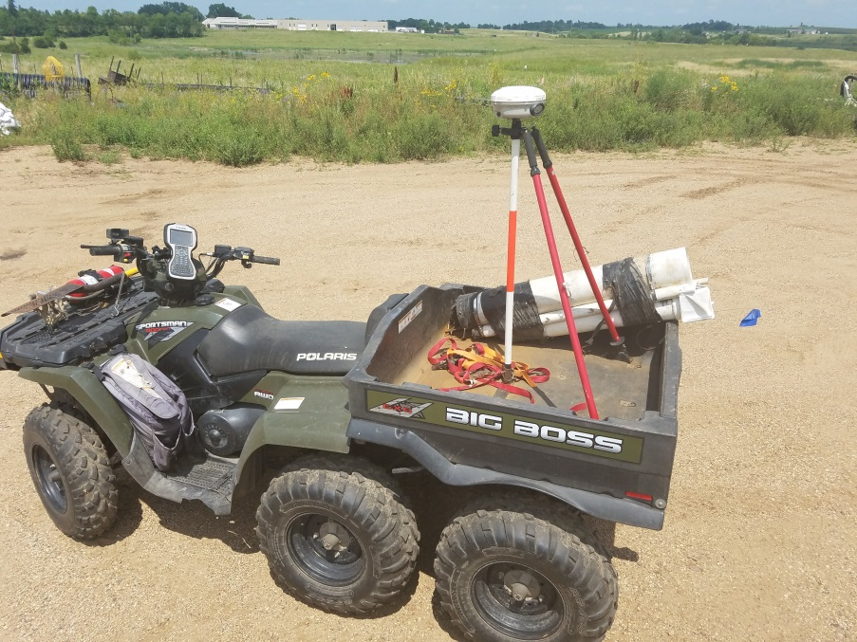
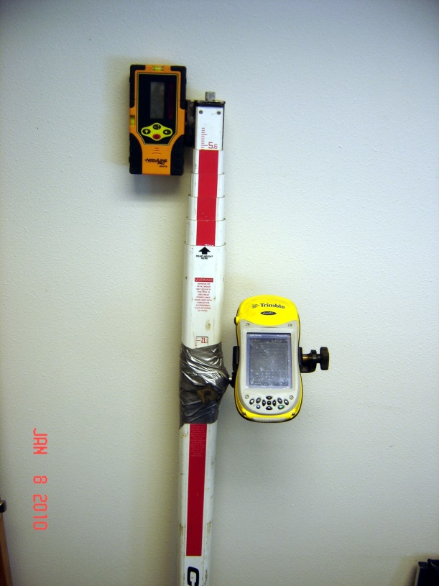
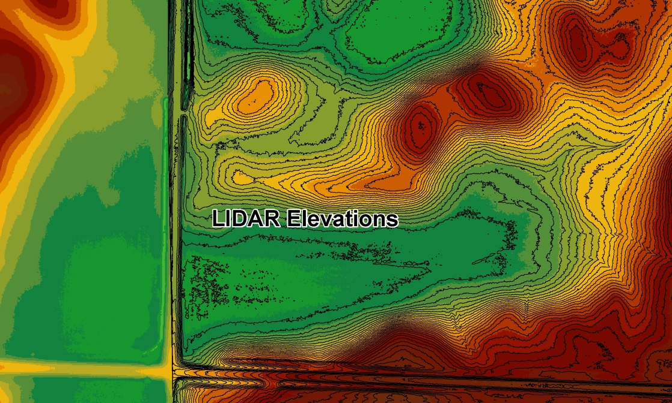
Probably use this?

Slide 4
Calculation of Cut/Fill Volumes
Complex terrain hard to accurately calculate based on station readings
Poor volume estimates impact cost over or under estimating bid volumes
Using digital 3D Terrain in GIS can get accurate volumes
Fast, easy construction staking using GPS
Potential to export to GPS guided grading in construction equipment for finish work

Slide 5
Need digital elevation data to make a 3-dimentional model of the landscape in GIS
Garbage in/Garbage out. Better quality survey data will result in more accurate calculations
Use survey grade GPS in hand pole method or continuous topo mode on ATV
Using laser level, tie shots to a GPS point
Use a Geoditic Benchmark to tie to MSL elevation
Or integrate with LIDAR using a common point like center of a road intersection to get MSL

Slide 6
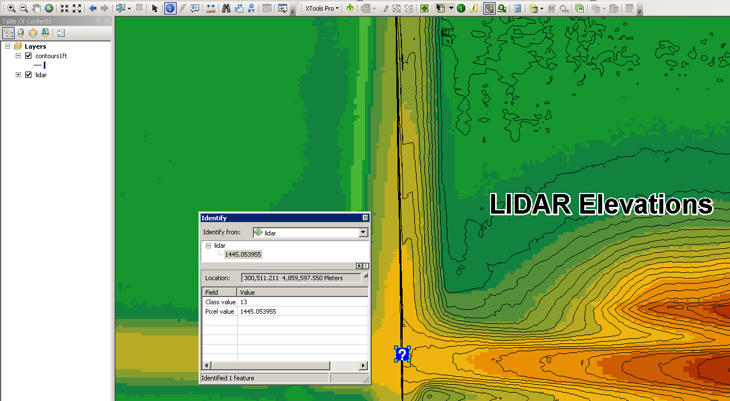
Using LIDAR Elevation at a road intersection to tie to laser level surveys

Slide 7
Need digital elevation data
Use LIDAR Elevations
Download LIDAR for your state/county etc.
Most LIDAR is accurate within 6 inches or less for hard surfaces like crop ground, upland grasslands, particularly good on roads.
Does not penetrate water or heavy thick vegetation like trees or cattail
Can easily develop hybrid maps using LIDAR for upland areas and fill in low wet areas with survey data.

Slide 8
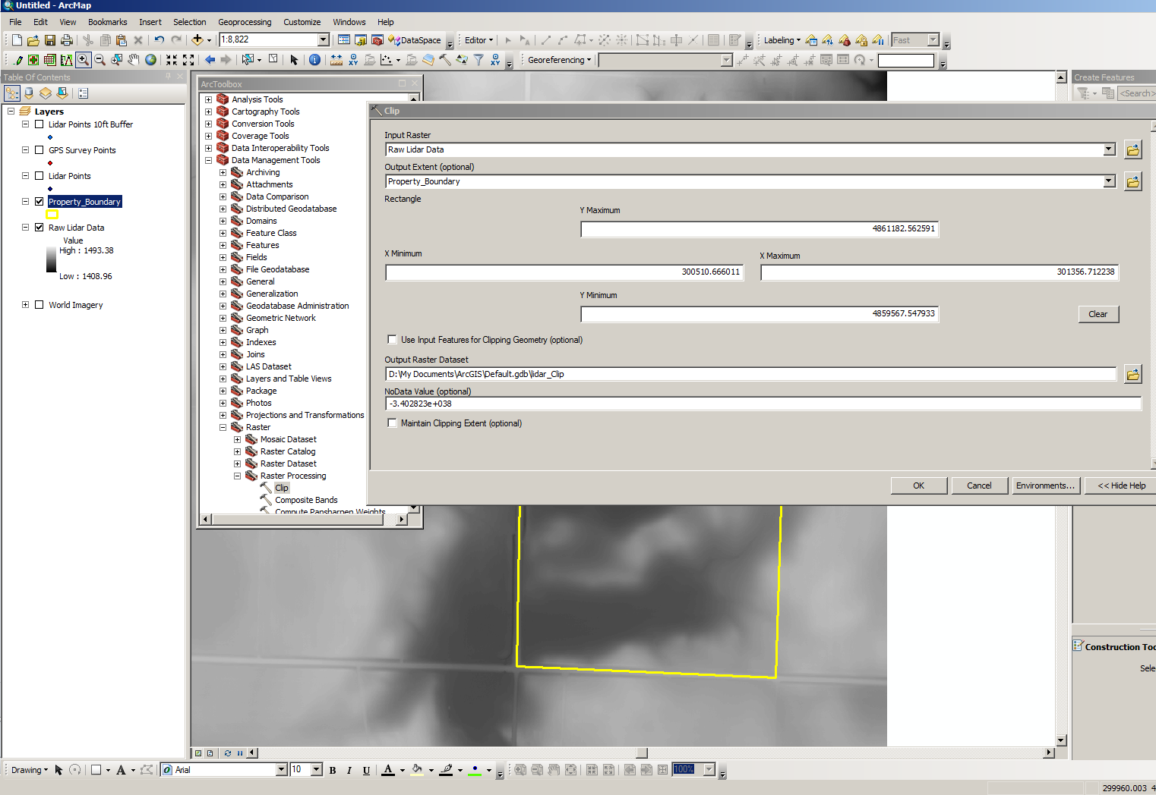
LIDAR usually comes in “Raster” form. Clip to your Work Area Convert to 3D TIN or to a Point File

Slide 9
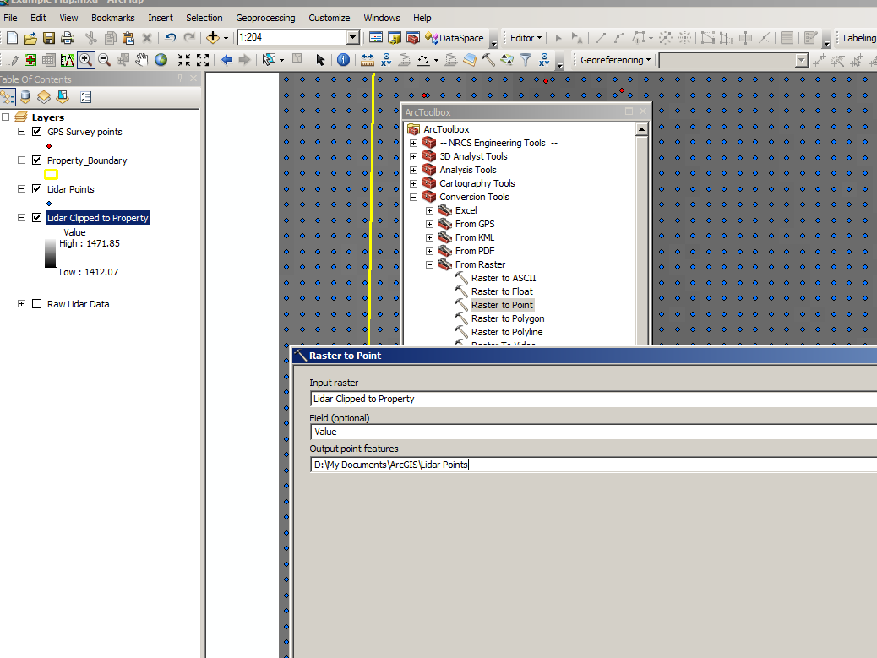
Convert your LIDAR to point files

Slide 10
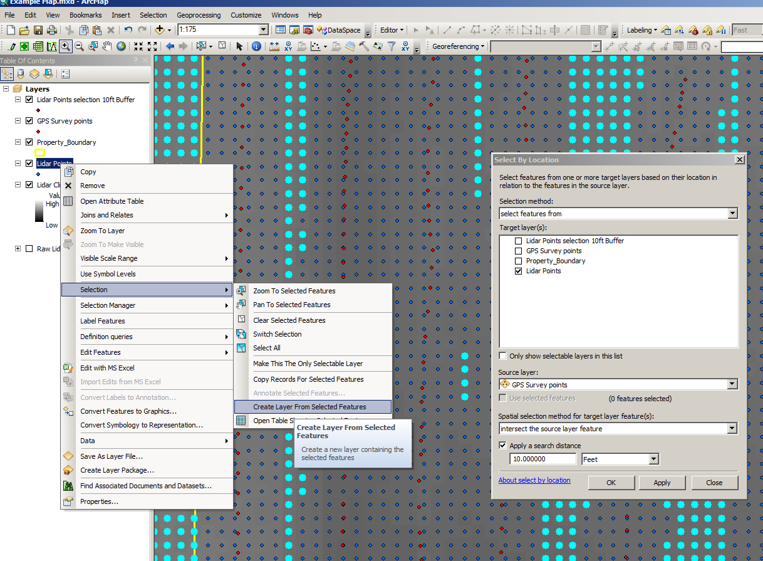
Buffer the LIDAR data by the Survey Points

Slide 11
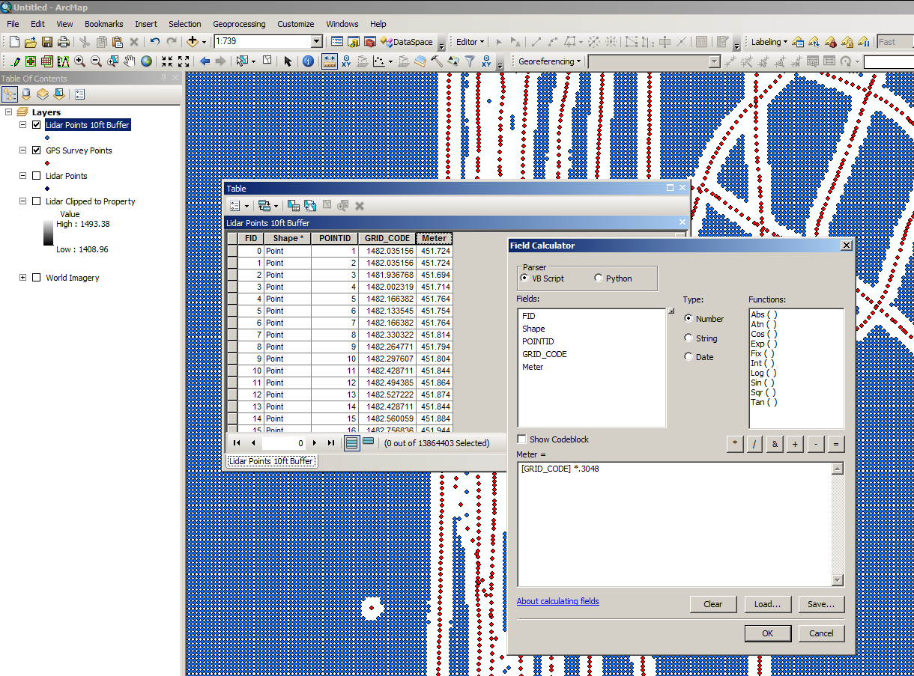
Match the Elevation Units to the units in the coordinate system. For UTM NAD83 or WGS84 use Meters

Slide 12
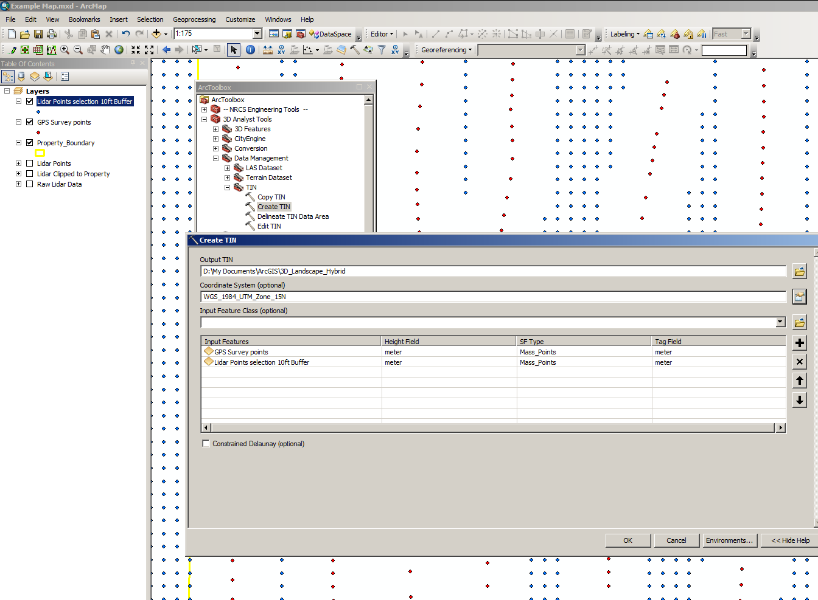
Create Hybrid Landscape For Survey & LIDAR Data

Slide 13
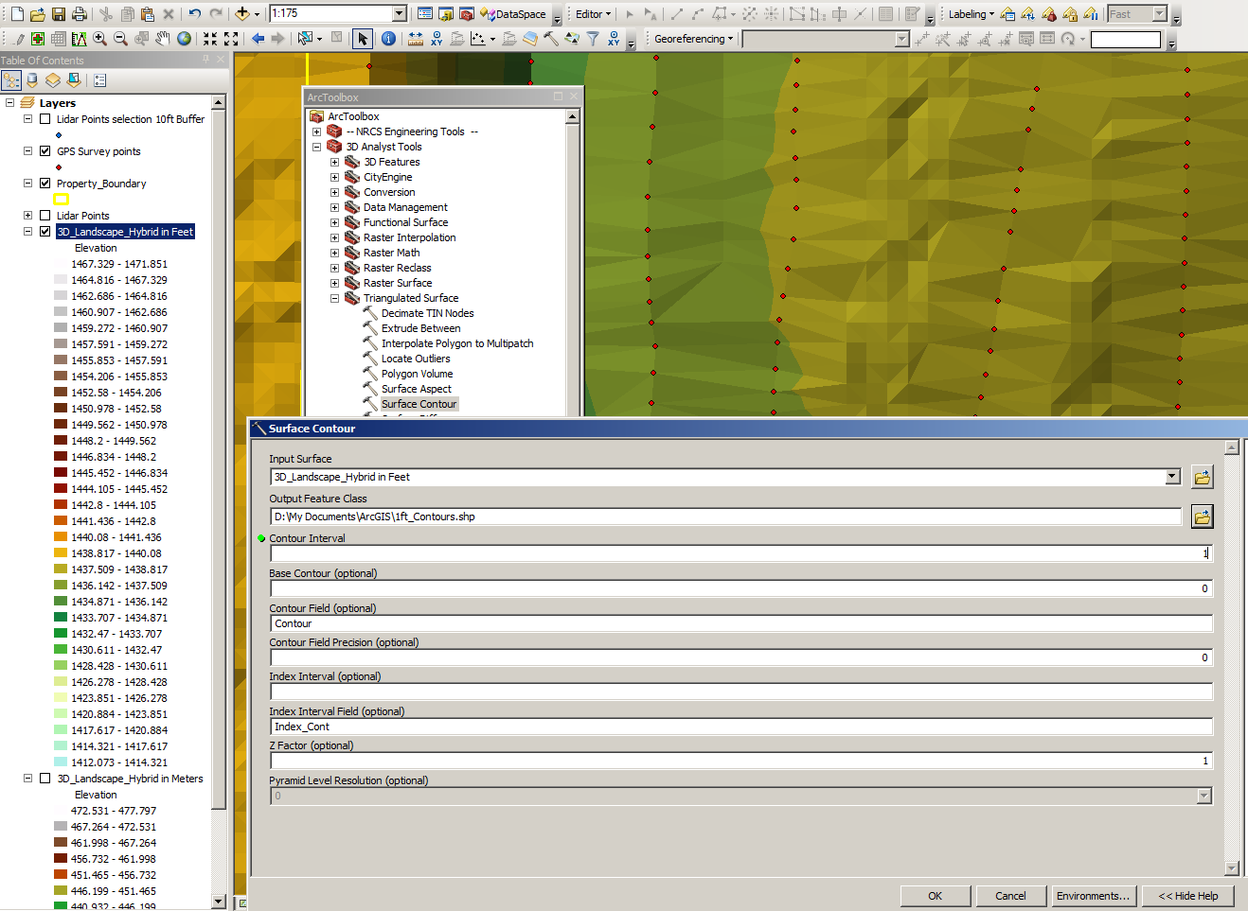
Create Contour Lines

Slide 14
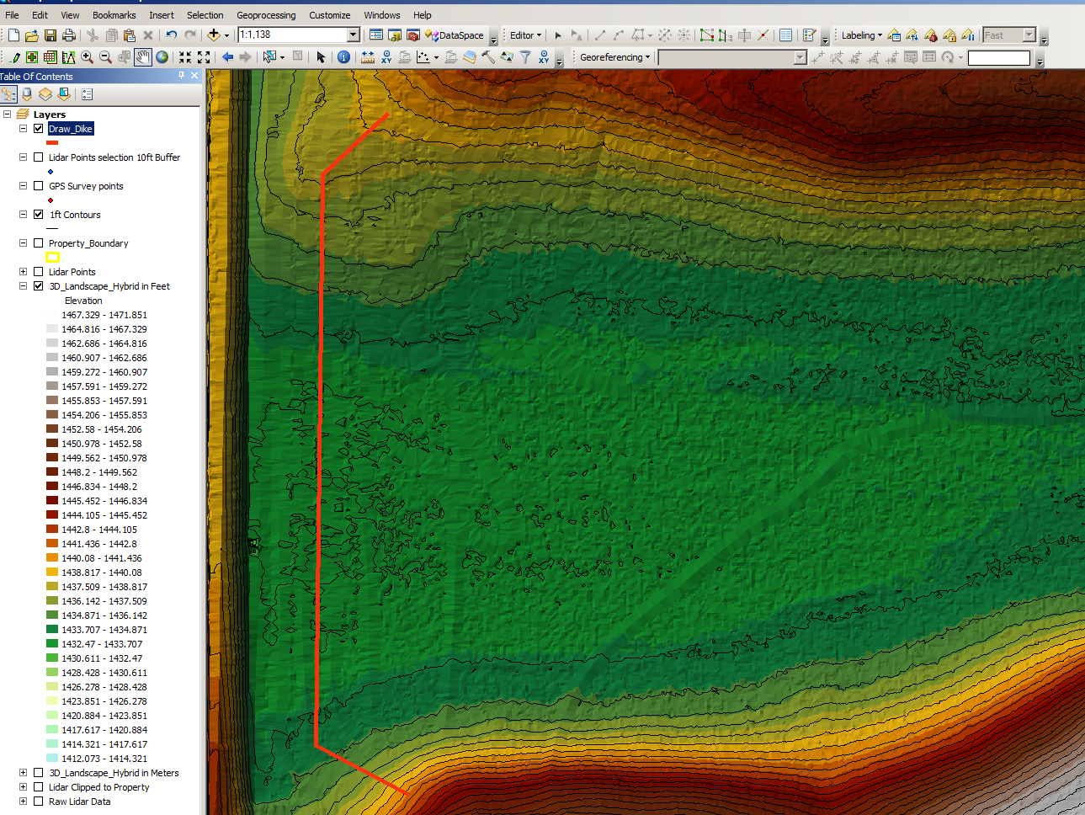
Draw dike center line.
Over-draw longer than you think you need it.

Slide 15
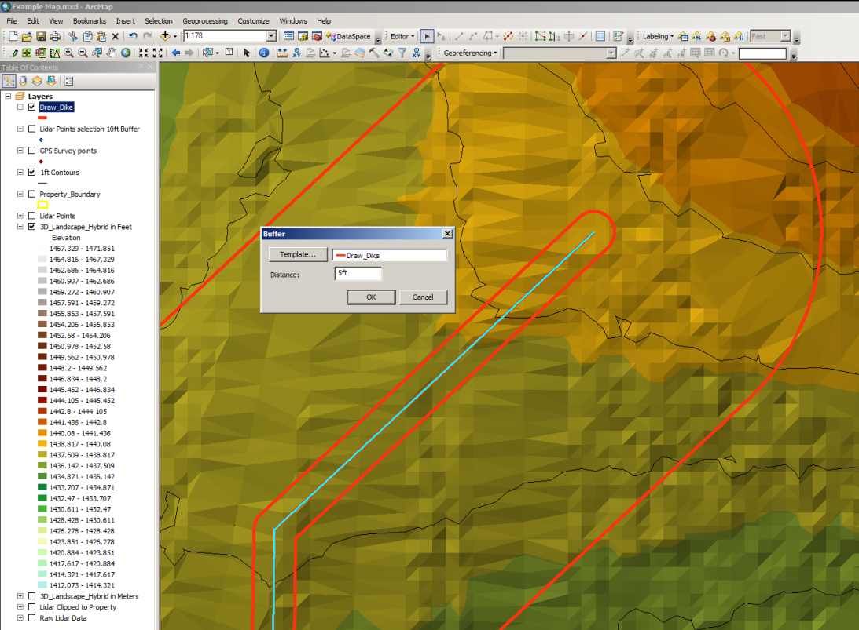
Draw dike center line.
Buffer for top width.
Buffer for Slope Length.
Slope, over estimate .
If 6ft tall dike with 5:1, Buffer 10ft tall so 5X10=50ft, Overestimate

Slide 16
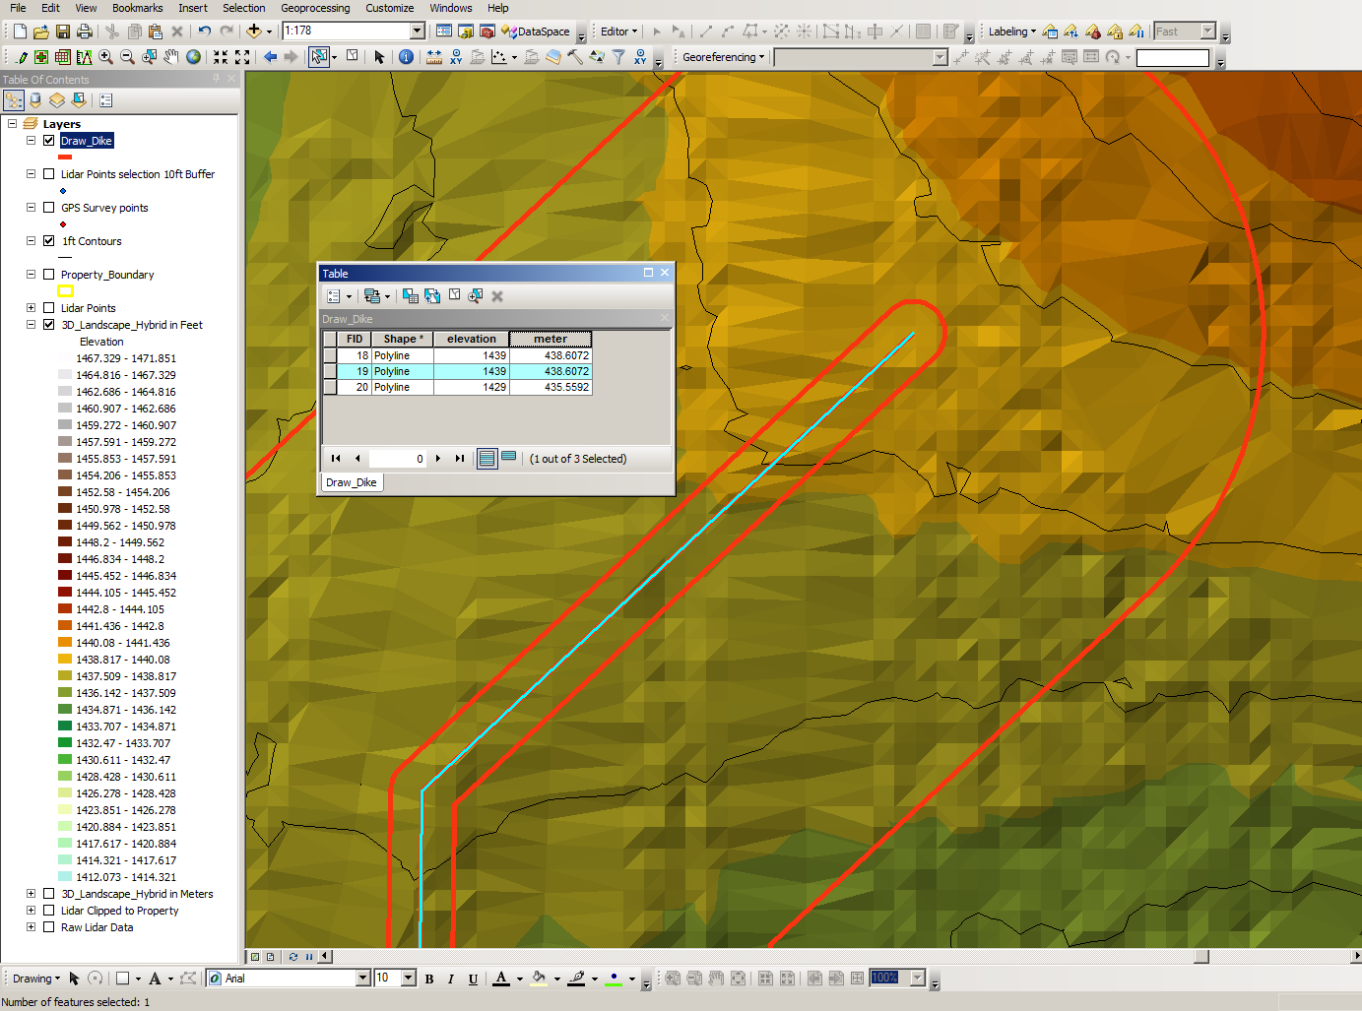
Assign elevations to lines.
Convert to Meters.
If toe of slope is 50ft at 5:1 then elevation of toe is 10ft lower than the top.

Slide 17
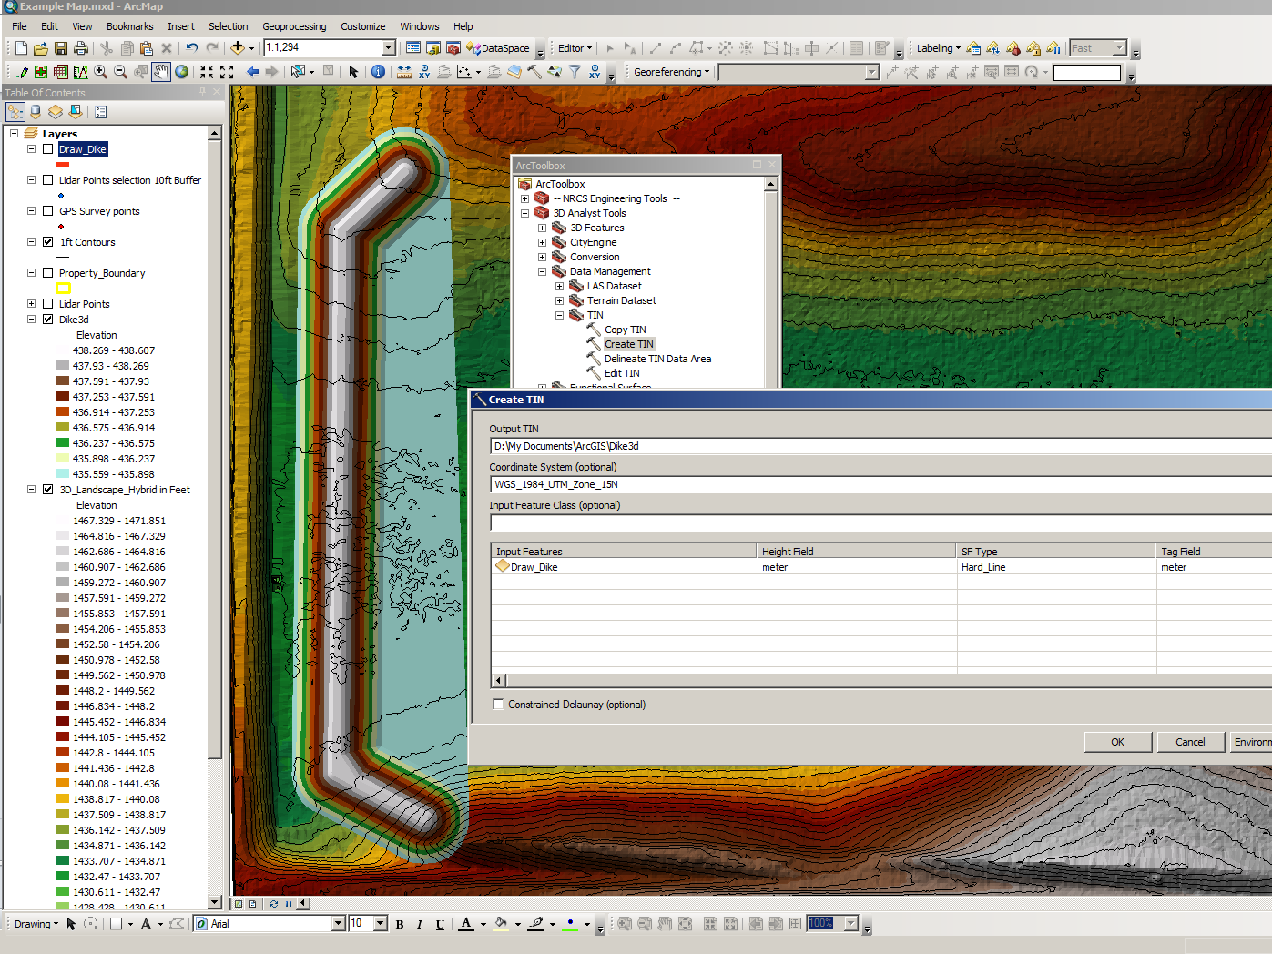
Create 3D TIN for the dikes

Slide 18
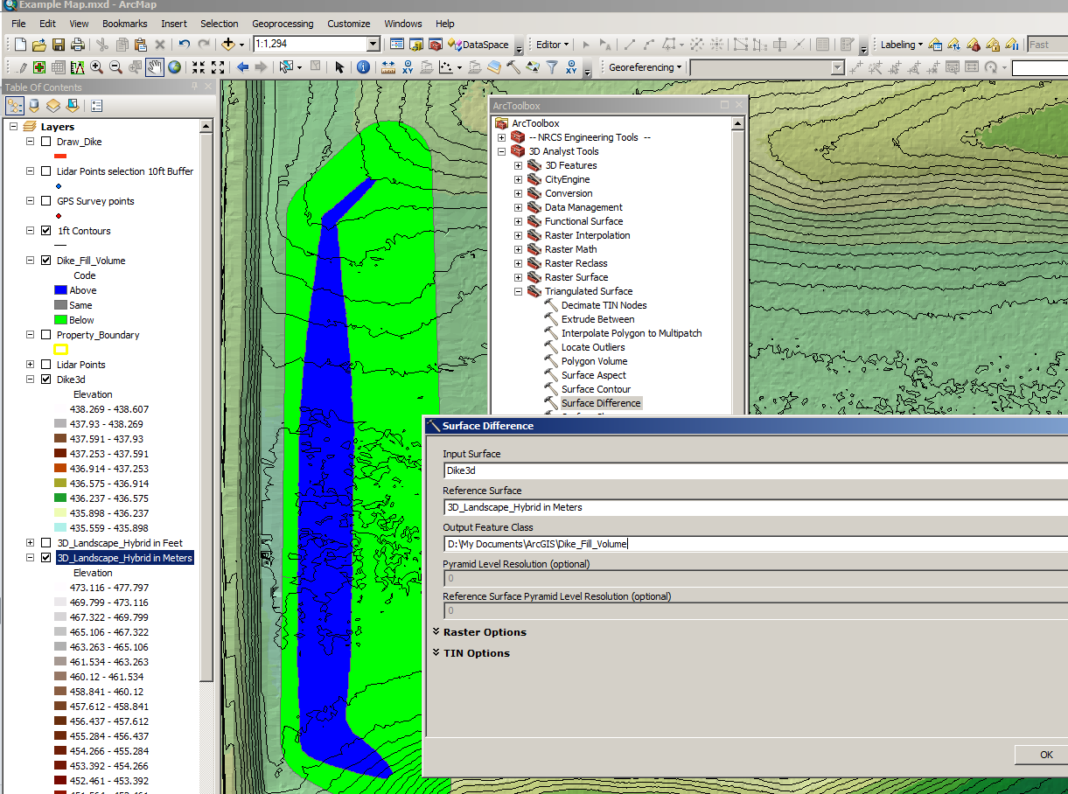
Use Surface Difference Tool to calculate cut/fill volumes

Slide 19
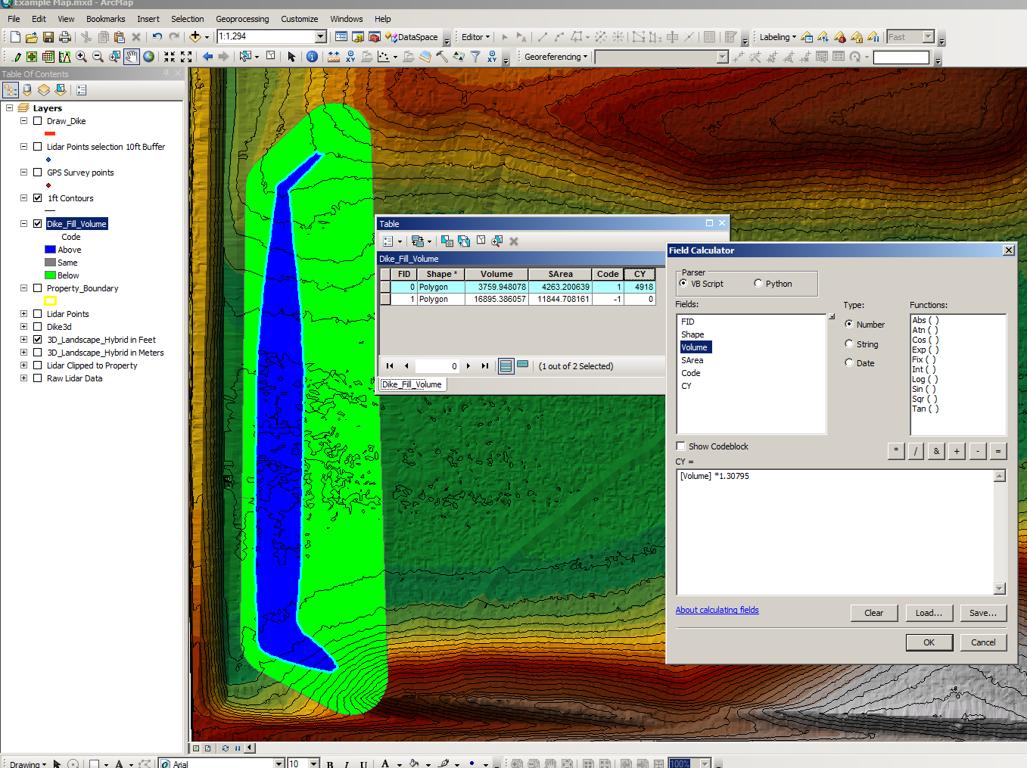
Volumes are in Cubic Meters, Area is Square Meters, Convert to Cubic Yards & acres.
Delete non-relevent data

Slide 20
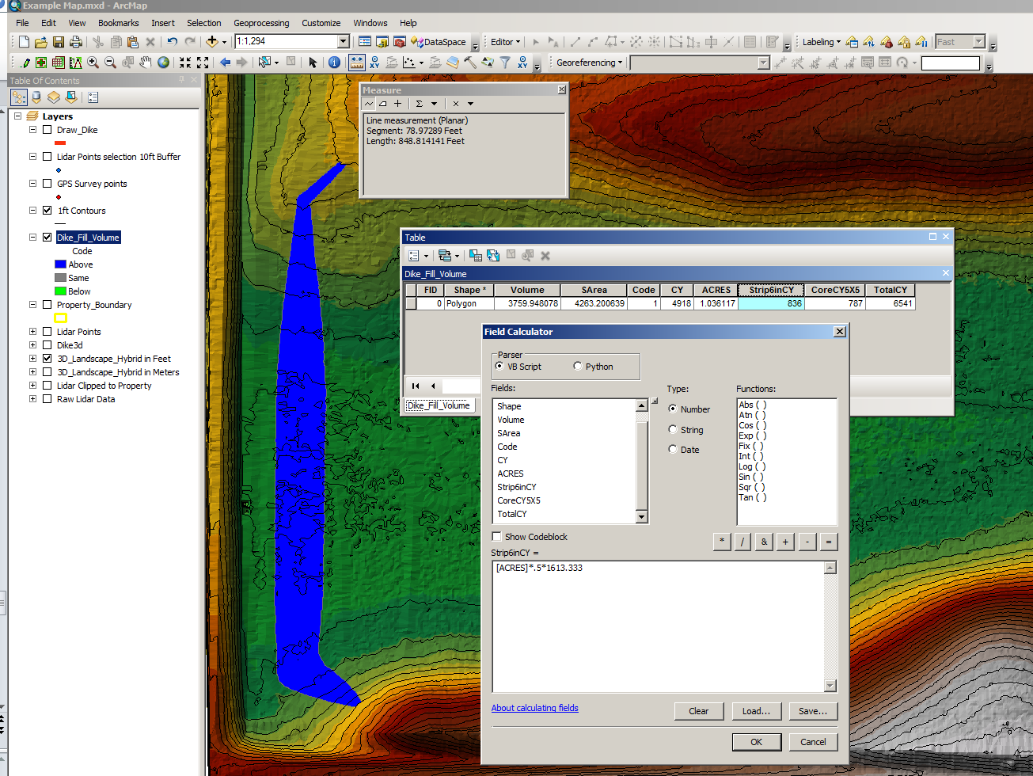
For Sod Stripping, take Depth X Area X Unit conversions.
For Core Trench, measure Length of desired Trench X Width X Depth X Unit Conversions

Slide 21
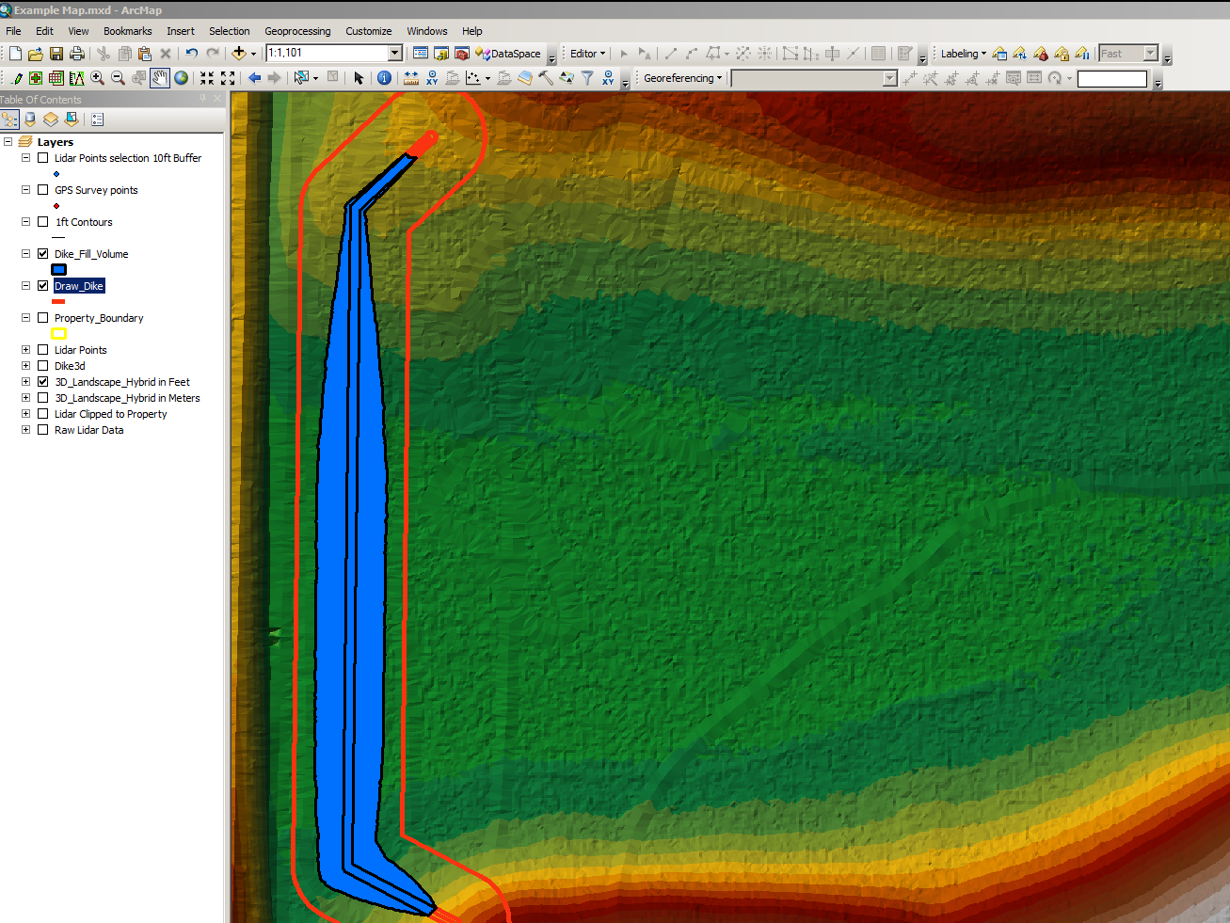
Cut Dike Fill Polygon to divide top from slopes

Slide 22
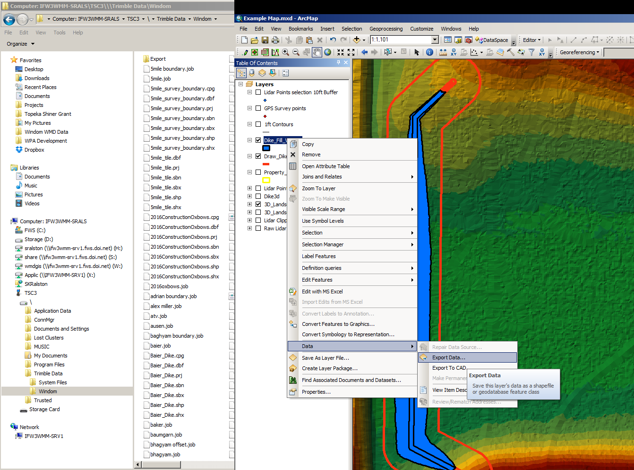
Export Dike Shapefile to GPS for construction staking

Slide 23
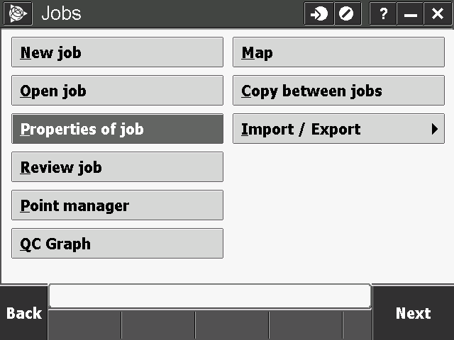
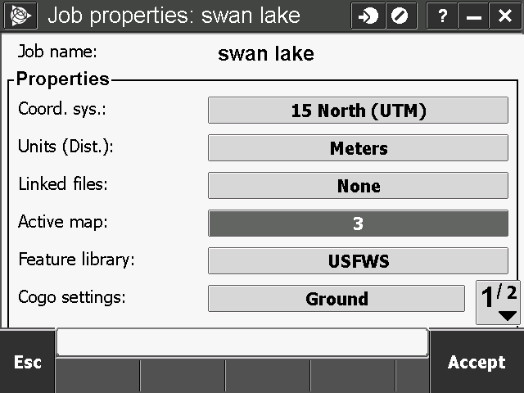
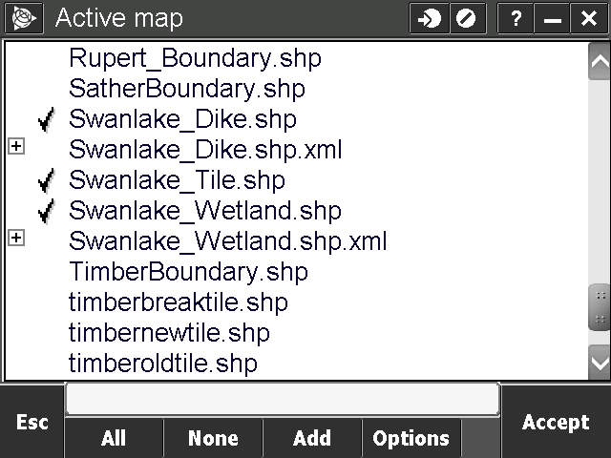
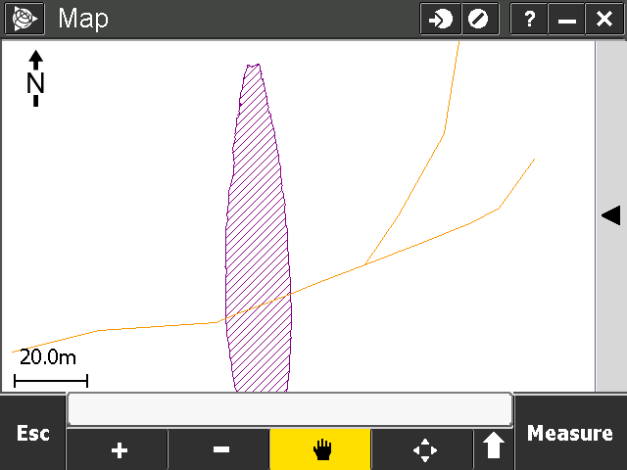
Use GPS in field with Shapefile displayed as the Active Map to mark out dike footprint/toe, centerline or top.

Slide 24
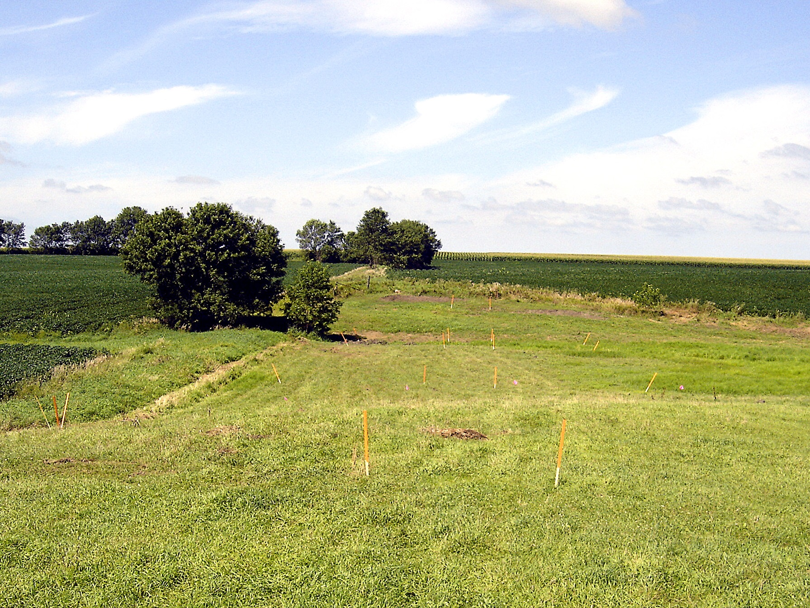
Use GPS in field with Shapefile displayed as the Active Map to mark out dike footprint/toe, centerline or top.

Slide 25
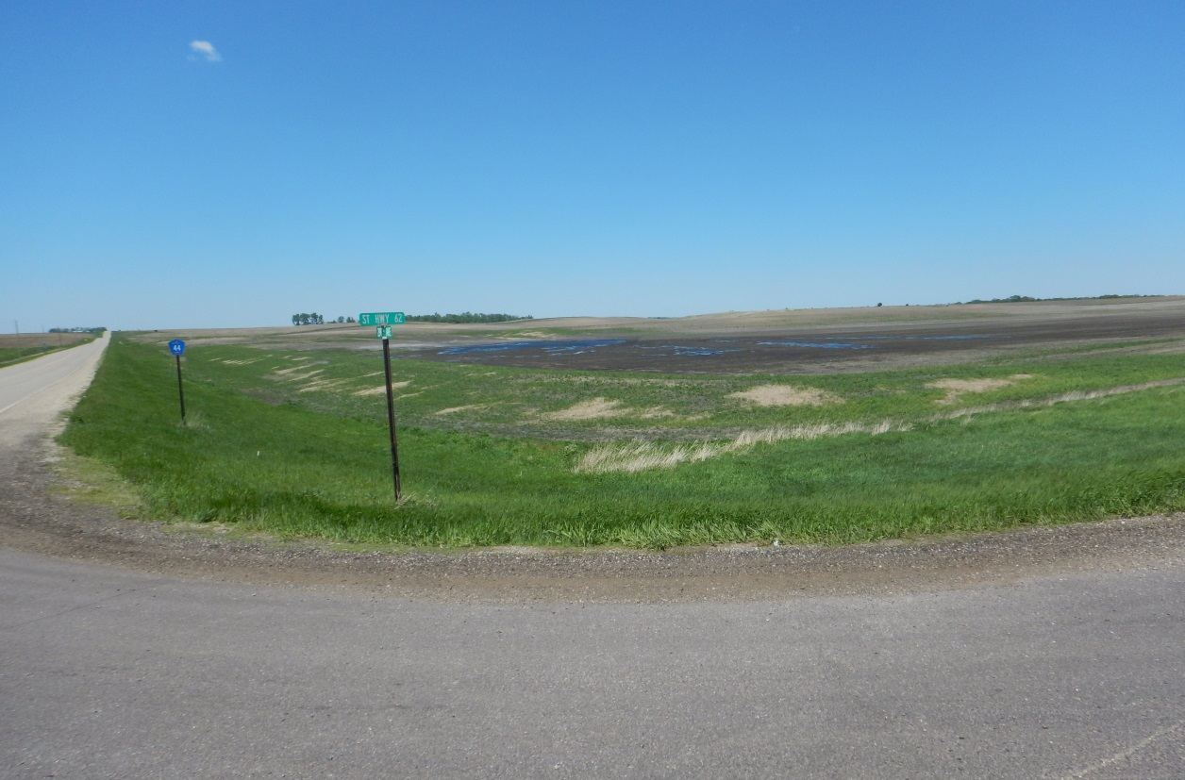
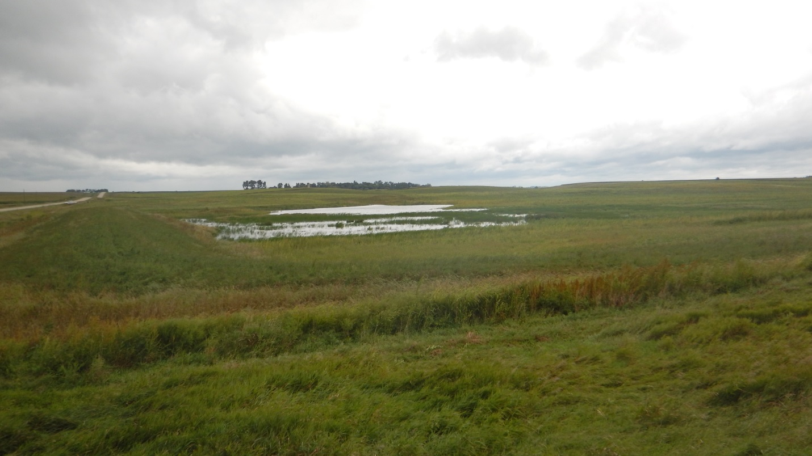
Available for Download from:
SKRalston.com/USFWS/
Thank
You!

